Slide 1
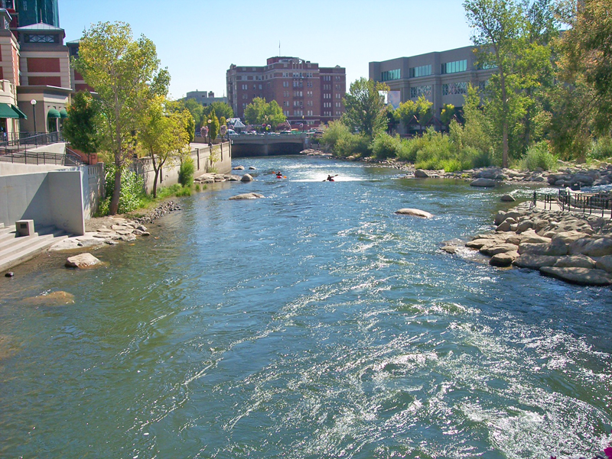
City of Reno
FY21/22 Budget Workshops
March 29, 2021
March 30, 2021
March 31, 2021

Slide 2
Agenda:
Departmental Overview
Core Services, Strategic Plans, Additional Funding Requests, & Fee Schedule
  Community Development
  Parks & Recreation
  Police
  Fire
  Public Works
  Utility Services
  City Manager
  Municipal Court
  City Attorney
  Information Technology
  Neighborhood Services
  City Clerk
  Civil Service
  Finance
  Human Resources
Notes:
Update once department order is finalized.

Slide 3
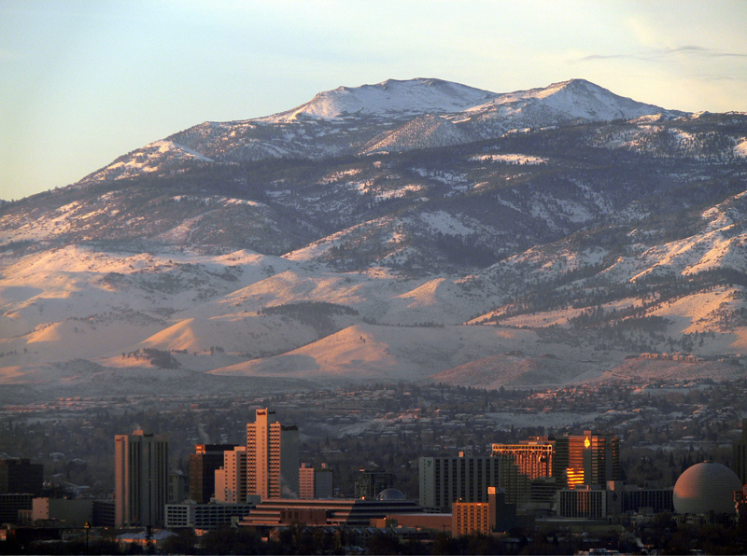
Community Development

Slide 4
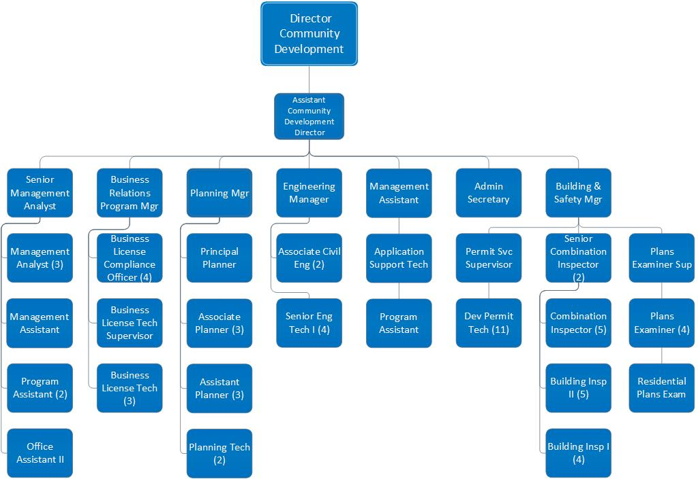
Community Development (75.10 FTE)

Slide 5
Departmental Core Services
Land Use Planning
  Comprehensive Planning Program
  Current Planning / Development Review
Building - Permit Review & Inspection
Engineering - Development Review & Inspection
Business Licensing
Housing and Neighborhood Development
Administrative Services

Slide 6
Top Accomplishments in FY20/21
Major Initiatives and Strategies for FY21/22
Top Accomplishments
  Adopted the RENOvation Zoning Code and updated all of the zoning/mapping applications, fee sheets, development review memo’s and intake calendars to be more user friendly.
  Implemented an electronic document review (“EDR”) system to allow all types of building permits to be submitted electronically.
  Collaboration with Regional partners on development and opening of the Nevada CARES Campus.
Major Initiatives and Strategies
Update Public Service and Facility Plans & Develop Funding Strategy (Fiscal Sustainability & Economic and Community Development)
Review and update zoning map designations and ordinances to be prioritized by Council (Economic and Community Development)
Implement changes to Accela to increase functionality of workflows, reports, and ease of use, thereby providing enhanced performance for customers and staff. (Economic and Community Development)

Slide 7
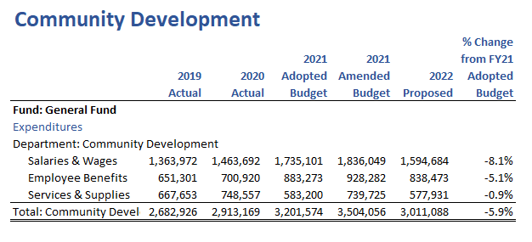
Financial Summary
Note: 2022 General Fund Budget should be $3,074,545 (±4.0% decrease from 2021)
Notes:
Decrease in salaries and benefits due to re-organization and shifting salaries from General Fund to the Building Fund.

Slide 8
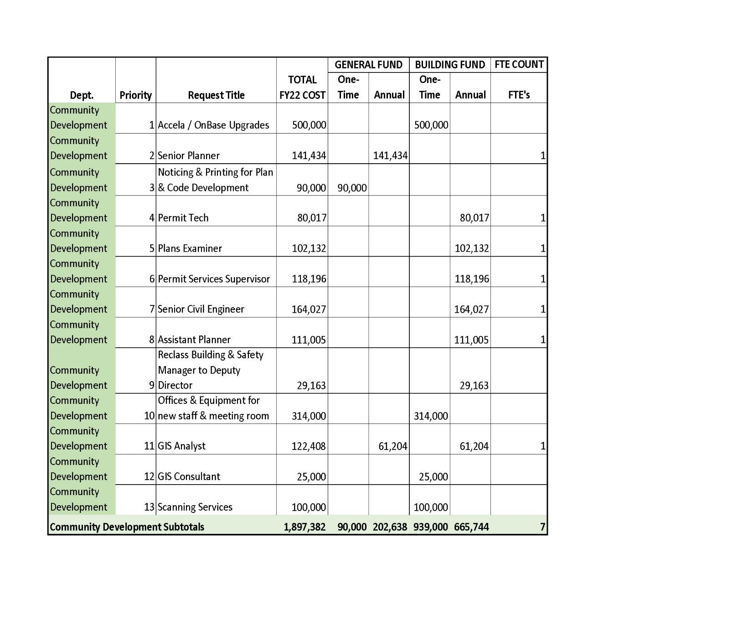
Additional Funding Requests

Slide 9

Parks & Recreation

Slide 10
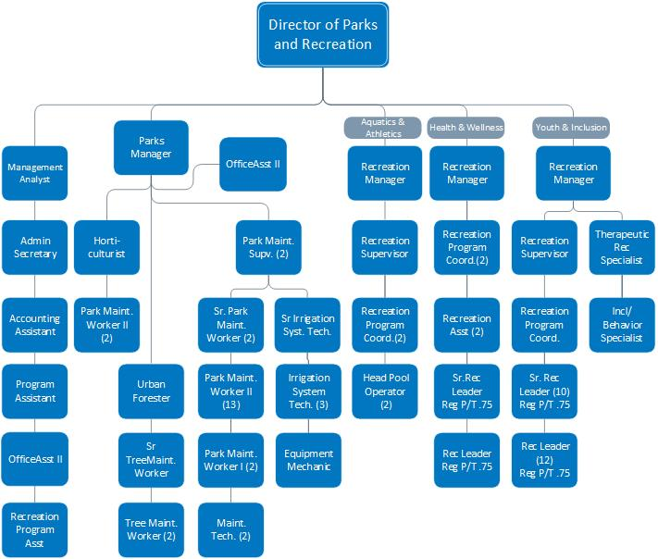
Parks & Recreation (76 FTE)

Slide 11
Departmental Core Services
Aquatics
Athletics
Accessibility – Inclusion & Adaptive Recreation
Health & Wellness
Park Maintenance
Program and Service Management
Resource Development/Customer Service
Youth Services
Urban Forestry

Slide 12
Top Accomplishments in FY20/21
Major Initiatives and Strategies for FY21/22
Top Accomplishments
  Completion of 7 significant construction projects in parks and pools
  Successful daily operations and service provision in 88 parks and over 27 different programs in rec facilities to the community during COVID pandemic
  Implementation of multiple service provision efficiencies and departmental restructuring
Major Initiatives and Strategies
  Fundraise $10M to reconstruct Moana Pool (Parks and Recreation)
  Update the 2008 Recreation Facilities Plan to create a more robust Parks, Recreation, and Open Space Service Plan (Parks and Recreation, Master Plan)
  Complete CDBG improvements at Paradise Park and Yori Park (Parks and Recreation)
Notes:
Completed 7 significant construction projects: Cyan Park Phase II, Mayor’s Park Phase 2 & Disc Golf Course, Idlewild Playground, Huffaker Park and Reno Tennis Center court renovations, chemical system conversion at all pools
Successful daily operations and service provision to the community during COVID Pandemic: all parks remained open, over 27 different programs offered including Vacation Station, Sierra Kids, aquatics at all 4 pools, EMNECC, & NRRC, virtual recreation, and monthly “recreation-in-a-box” activity kit distribution; other programs include lap swim, water fitness, swim teams, swim lessons, volleyball, kickball, cornhole, cardio & weight rooms, Pickleball, table tennis, badminton, Sit and Get Fit, Tai-Chi, Shuffleboard, Karate, Gentle Yoga, Badminton, Chair Yoga, Zumba, Hatha Yoga, Bean Bag Baseball, Minnesota, veterans programs, and adaptive equipment rentals
Implementation of multiple service provision efficiencies and departmental restructuring: creation of Health & Wellness division, implementation of fee increases to address mandatory minimum wage increases, creation of “Non-Career Path” employee category, ability to hire 15-year olds

Slide 13
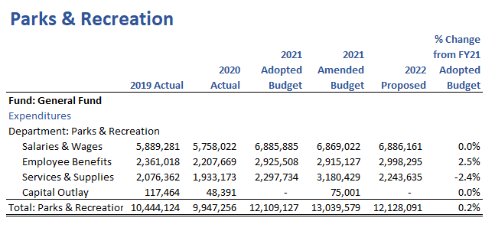
Financial Summary

Slide 14
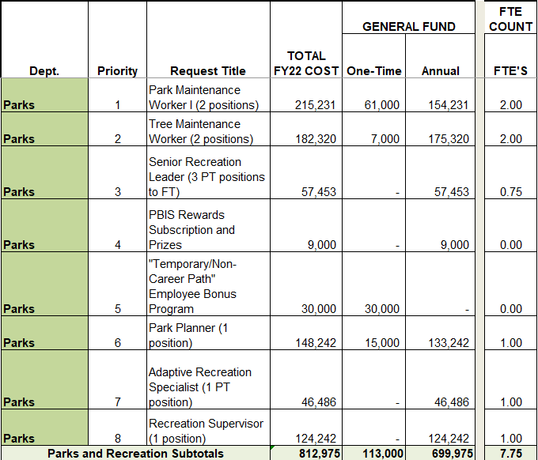
Additional Funding Requests

Slide 15
Police Department

Slide 16
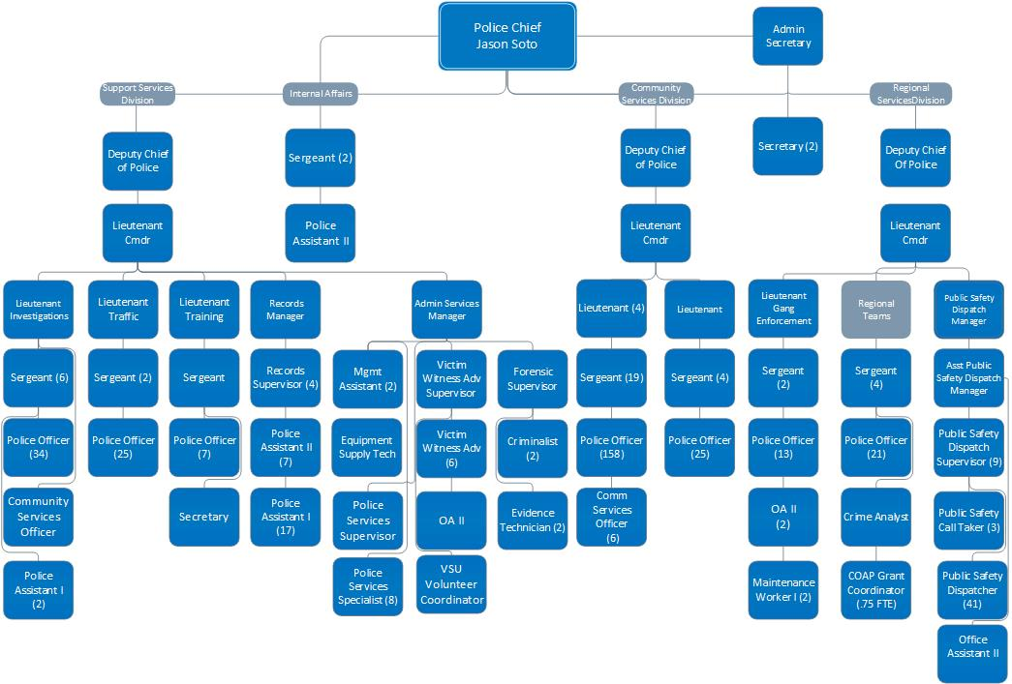
Police Department (470.75 FTE)

Slide 17
Departmental Core Services
Community Service Officers
Crime Prevention
Dispatch
Downtown Police
Gang Enforcement
Investigations
Program and Service Management
Records & ID
Traffic
Training

Slide 18
Top Accomplishments in FY20/21
Major Initiatives and Strategies for FY21/22
Top Accomplishments
Led local, state and federal law enforcement partners in the creation of regional units to improve investigations into several areas including Human Trafficking and Exploitation Investigations, Narcotics Investigations, Interdiction Investigations and others.
Increased staffing to the Community Action and Outreach Unit and coordinated with the City’s Clean and Safe program in anticipation of the upcoming CAREs campus.
Provided mandatory training in Cultural Competence to all department personnel.
Major Initiatives and Strategies
Improve compliance with Public Records requests and the National Incident-Based Reporting System reporting requirements. (Public Safety)
Seek funding from the Washoe County 911 Emergency Response Advisory Committee to implement a car dash camera system in all marked police vehicles, to enhance community trust and improve transparency. (Public Safety)
Increase sworn staffing levels to keep up with departmental attrition and to keep up with growth of the community. (Public Safety)

Slide 19
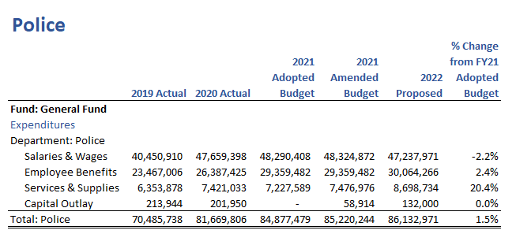
Financial Summary
Notes:
Decrease in Salaries due to larger than normal retirement rate and reduction in pay to offset increase in PERS rate
Increase for Benefits largely due to increase in PERS rate
Increase in services and supplies due to contract escalators, some of which have not been included in previous years, and a significant increase in the cost of ammunition. As well as an increase in transfers to fleet.

Slide 20
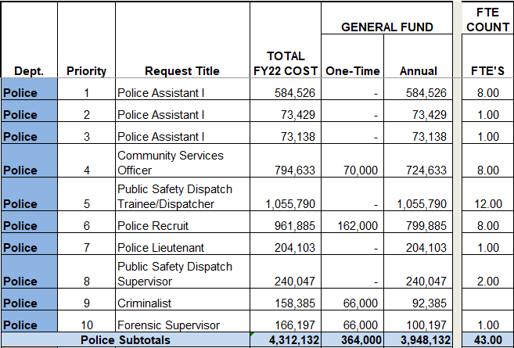
Additional Funding Requests

Slide 21
Fire Department

Slide 22
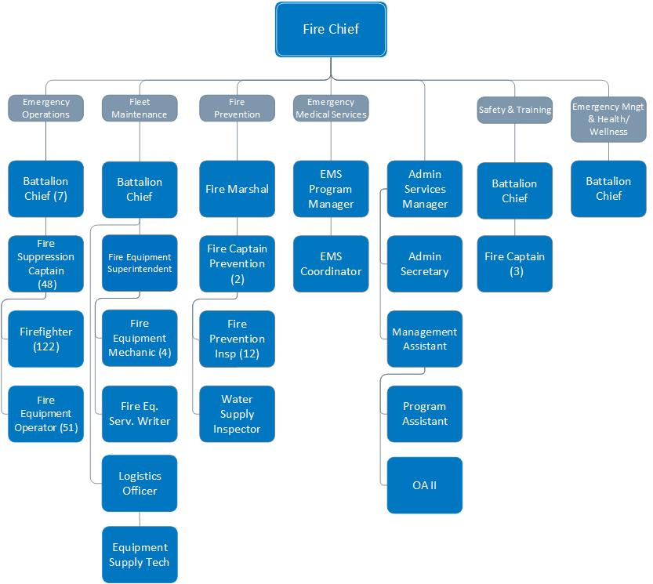
Fire (266 FTE)

Slide 23
Departmental Core Services
Emergency Medical Services
Emergency Operations
Fire Prevention
Fleet Maintenance
Program and Service Management
Safety and Training

Slide 24
Top Accomplishments in FY20/21
Major Initiatives and Strategies for FY21/22
Top Accomplishments
  Managed the busiest fire season on record, a worldwide pandemic (COVID-19), and over 40,000 calls for service
  Increased Department ALS Companies from 8 to 10.
  Department personnel (182 Firefighters) responded to over 59 wildland fires throughout the western states during the worst fire season on record.
Major Initiatives and Strategies
  Increase staffing to mitigate the negative affects high call volume has on the health and wellness of RFD personnel, and provide the highest level of service to Reno. (Public Safety)
  Advance, expand and staff Emergency Management efforts regarding the response, mitigation and recovery of major infectious disease events (pandemic). (Public Safety)
  Continue to develop and research funding strategies and grant opportunities for a systematic replacement/renovation program to address the needs of our aging fire stations. (Public Safety)

Slide 25
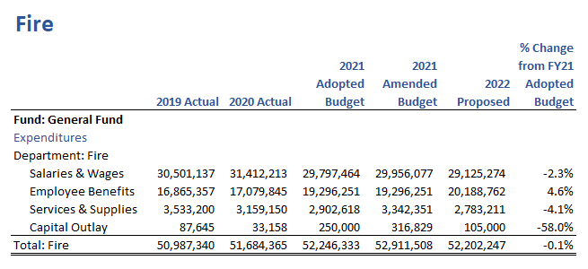
Financial Summary
Notes:
Salaries - FY21 was budgeted higher to account for the anticipated IAFF contract back pay agreement. FY22 aligns with updated salary schedules and anticipated contractual increases.
Benefits - FY22 includes IAFF & RFDAA contractual increased for uniforms and OPEB in addition to the PERS increase
Capital Outlay – moved to Capital Fund

Slide 26
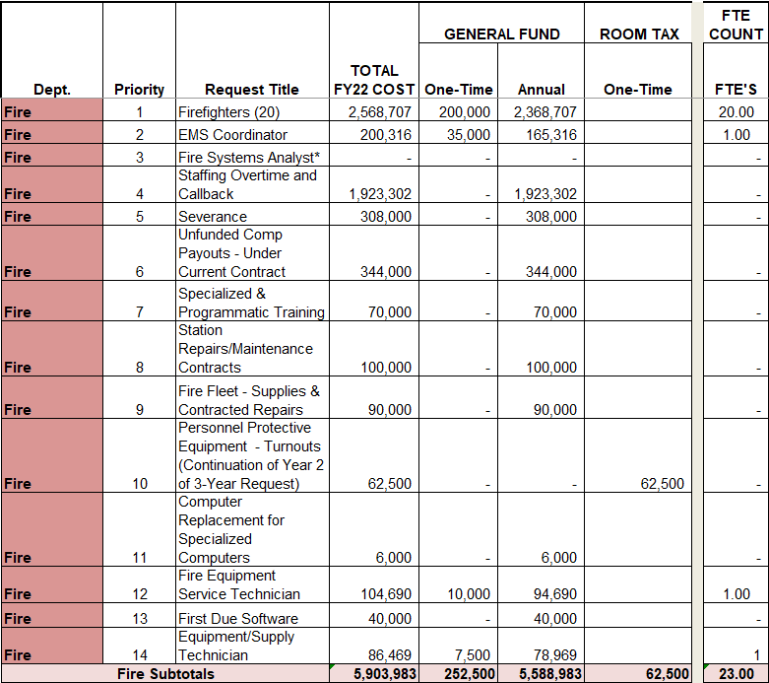
Additional Funding Requests
*DoIT has requested a Systems Analyst that will report through DoIT and will focus heavily but not solely on Fire related responsibilities. Costs are captured under that request.

Slide 27
Public Works

Slide 28
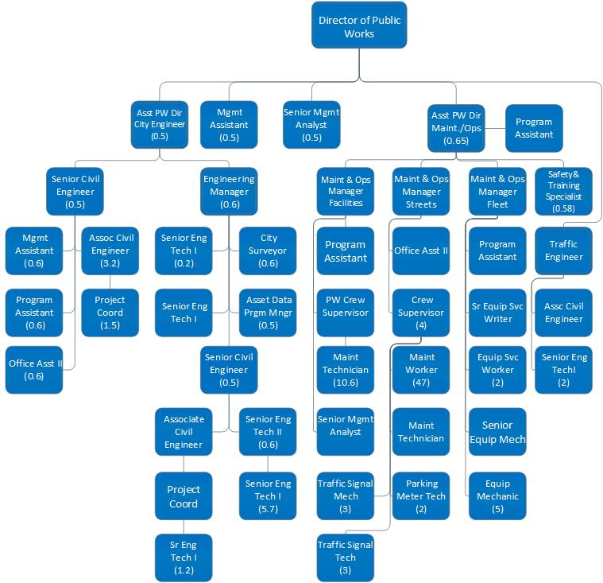
Public Works (116.23 FTE)

Slide 29
Departmental Core Services
Administration
Capital Projects – Engineering
Maintenance and Operations
  Facility Maintenance
  Fleet Management
  Street Maintenance
Traffic Engineering and Operations

Slide 30
Top Accomplishments in FY20/21
Major Initiatives and Strategies for FY21/22
Top Accomplishments
Nevada Cares Campus - plan, design, and construction
COVID-19 Response and Safety Protocol Implementation
Comprehensive School Zone Safety Audit and Correction of Deficiencies
Major Initiatives and Strategies
Construction of 1st Phase of Public Safety Center (Public Safety)
Improve Pedestrian Safety through Collaboration with Vision Zero Task Force (Public Safety)
Move City Asset Databases to ESRI Interface for Data Driven Decision Making (Infrastructure, Climate Change & Environmental Sustainability)

Slide 31
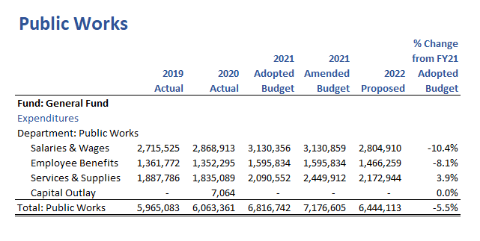
Financial Summary
Notes:
S&B - Department re-allocated a number of positions to Street and Sewer fund to meet Finance requested reductions to General Fund expenses

Slide 32
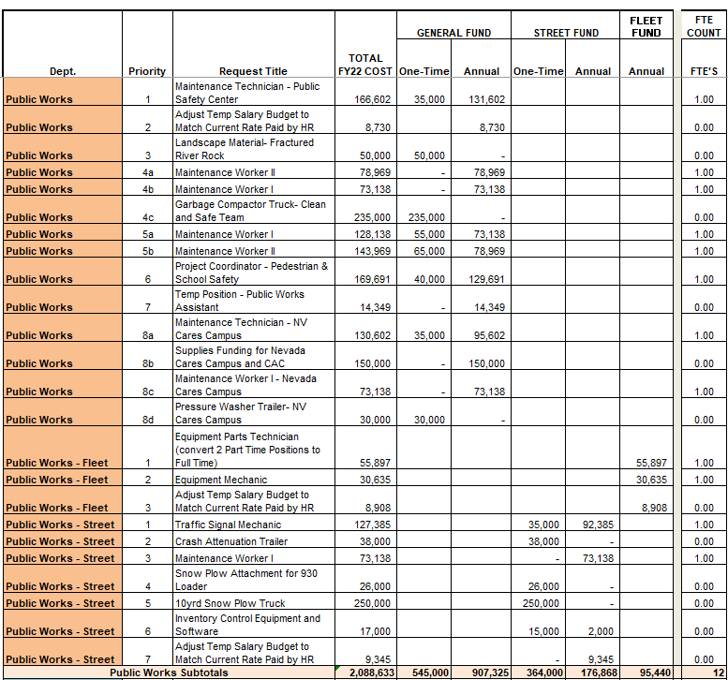
Additional Funding Requests

Slide 33
Utility Services

Slide 34
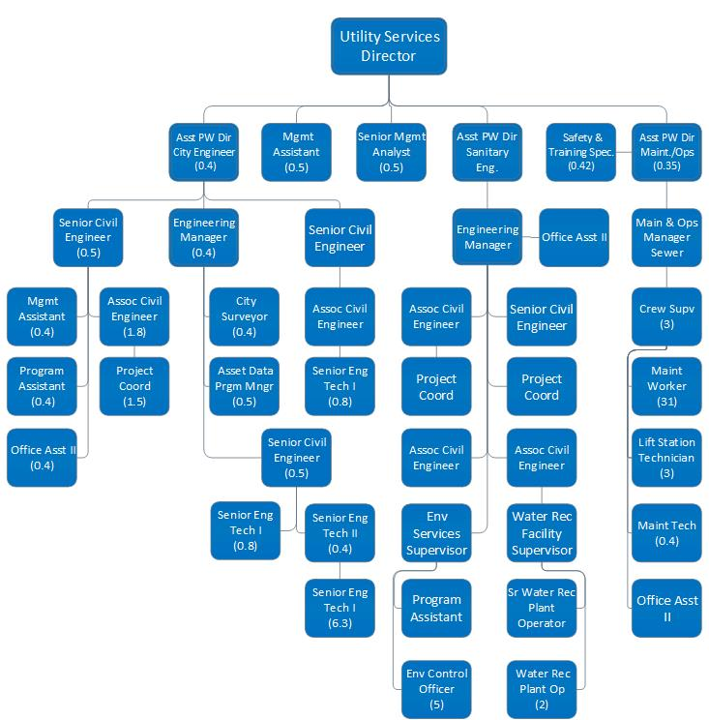
Utility Services (79.67 FTE)

Slide 35
Departmental Core Services
Capital Projects
  Engineering, Administration, & Operations
Environmental Engineering
Environmental Control
Sewer & Storm Drain Maintenance

Slide 36
Top Accomplishments in FY20/21
Major Initiatives and Strategies for FY21/22
Top Accomplishments
Began Construction of RSWRF Expansion
Completed successful OneWater Nevada pilot project for Advanced Water Treatment
Stormwater Utility Feasibility Study and Approval to Implement
Major Initiatives and Strategies
Construct RSWRF Expansion from 2MGD to 4MGD (Infrastructure, Climate Change & Environmental Sustainability)
Finalize design of Advanced Water Treatment and associated infrastructure for American Flat Aquifer Storage and Recovery (Infrastructure, Climate Change & Environmental Sustainability)
Implement the Stormwater Utility to provide stable funding for flood resilience projects to improve flood response (Infrastructure, Climate Change & Environmental Sustainability)

Slide 37
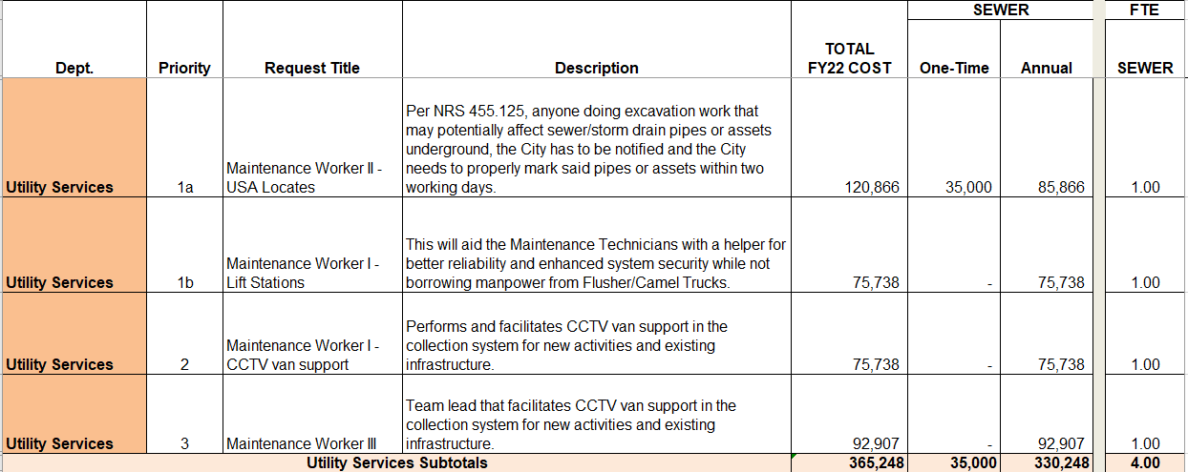
Additional Funding Requests

Slide 38
City Manager

Slide 39
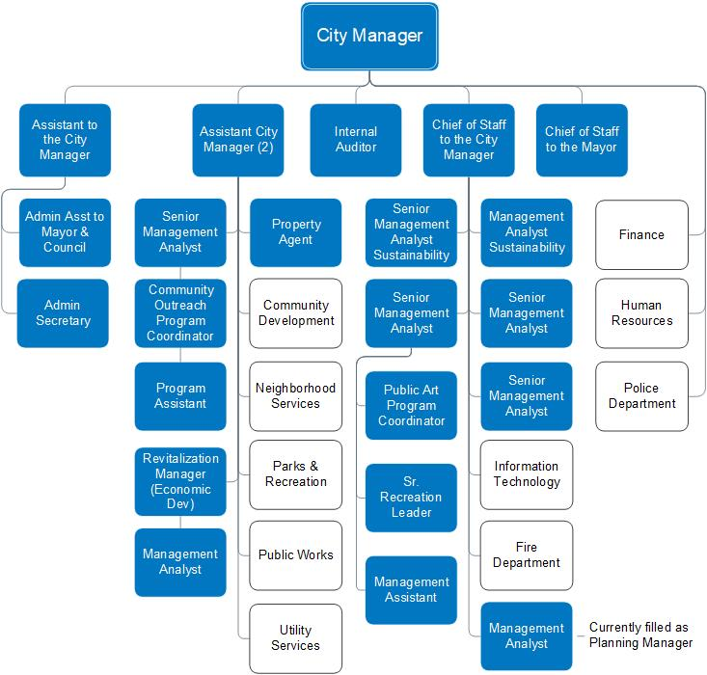
City Manager (24 FTE)

Slide 40
Departmental Core Services
Administration
Arts, Culture & Special Events
Clean & Safe Program
Economic Development
Sustainability, Policy and Strategy

Slide 41
Top Accomplishments in FY20/21
Major Initiatives and Strategies for FY21/22
Top Accomplishments
  Coordinated regional health and safety responses with local and state agencies on identified guidelines, and enforcement of state directives as well as managed the distribution of the City’s $46.7 million allocation of Coronavirus Relief Funds.
  Acquired the Governor’s Bowl and adjacent parcel to create a new, permanent, multi-services campus to assist individuals experiencing homelessness.
  Received over $11 million in revenue through City property sales and the receipt of Arts and Culture grant awards.
Major Initiatives and Strategies
  Introduced a strategic goal setting process to City departments and employees, creating objectives and goals that can be supported through all levels of the City, creating a positive and forward-thinking employee culture. (Fiscal Sustainability)
  Develop a resilient budget by working toward a zero based budgeting program that will support the Strategic Plan and Council-established priorities. (Fiscal Sustainability)
  Facilitate community recovery through City services and regional collaboration in the wake of the COVID-19 pandemic. (Economic and Community Development)

Slide 42
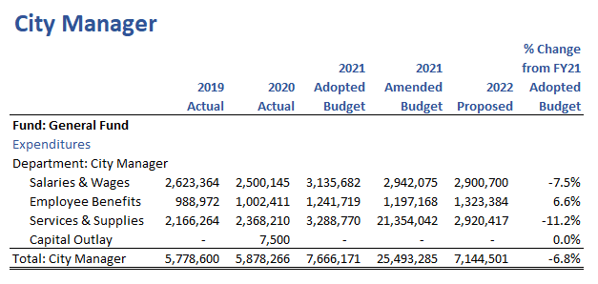
Financial Summary
Notes:
Salaries – Reduced due to turnover in numerous high level positions
S&S – Department submitted reductions

Slide 43
Municipal Court

Slide 44
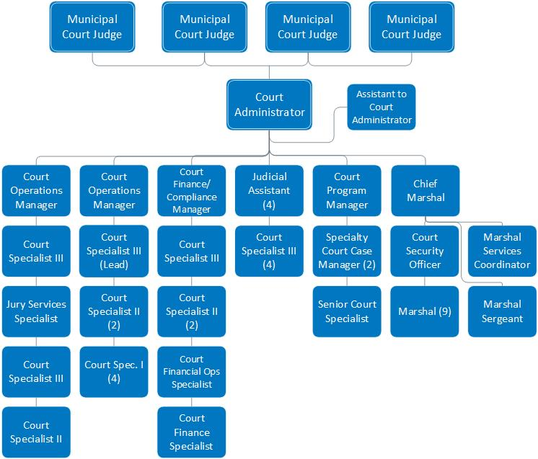
Municipal Court (50 FTE)

Slide 45
Departmental Core Services
Judicial Proceedings
Program and Service Management
Specialty Courts
Judicial Enforcement

Slide 46
Top Accomplishments in FY20/21
Major Initiatives and Strategies for FY21/22
Top Accomplishments
  Upgraded the court’s case management system, which now supports batch scanning, electronic file stamping, automatic routing and electronic signatures
  Developed, tested and launched
  a mobile phone application with embedded court forms and payment services
  Updated courtroom technology to allow the display of exhibits in a digital format, thus eliminating the need to physically handle countless documents
Major Initiatives and Strategies
  Maintain a model court environment by evaluating and enhancing court operations to better serve the needs of the general public and criminal justice community (Public Safety)
  Advance the use of technology to meet the electronic expectations of today’s court users (Fiscal Sustainability)
  Continue to support and expand specialty court programs by utilizing funds provided by federal, state and local grants to effectively serve the growing population of specialty court participants (Public Safety)

Slide 47
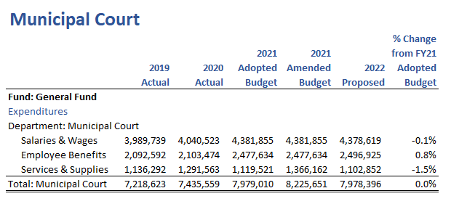
Financial Summary

Slide 48
City Attorney

Slide 49
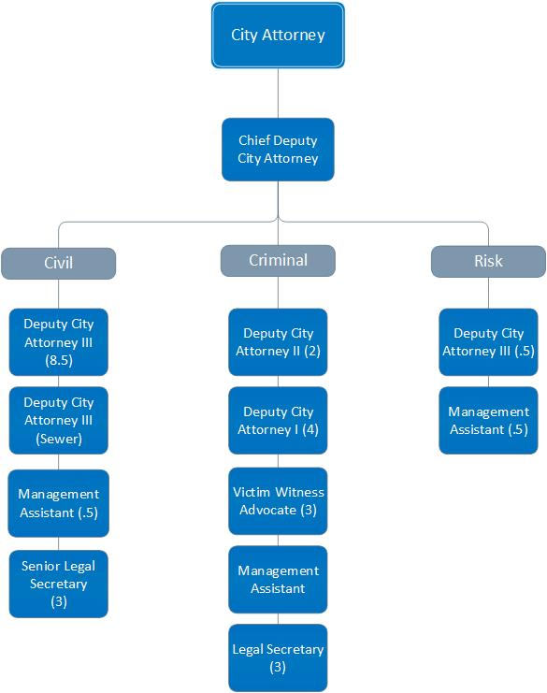
City Attorney (29 FTE)

Slide 50
Departmental Core Services
Civil Division
  Legal Services
  Client Relationships
  Resource Efficiencies
  Employee Enhancements
Criminal Division
  Arrest Warrant Services
  Arraignment and Trial Services
  Victim/Witness Services
  Grant Program Services
  Community Outreach & Training
  Traffic Arraignments
Risk Division
  Administer Risk Fund
  Exposure Reduction
  Pursue Recoveries
  Insurance Coverage

Slide 51
Top Accomplishments in FY20/21
Major Initiatives and Strategies for FY21/22
Top Accomplishments
  Advice and guidance on the City’s COVID-19 pandemic response
  Acquisition and development of the Governor’s Bowl and Nevada Cares Campus
  Resolved Cathy Woods v. City
Major Initiatives and Strategies
  Assist CD to revised and update select sections of Title 18 (Fiscal Sustainability)
  Address anticipated increase in civil litigation case load (Fiscal Sustainability)
  Aggressively prosecute DUI, domestic violence, graffiti and nuisance cases (Public Safety)
Notes:
ADD COUNCIL PRIORITIES

Slide 52
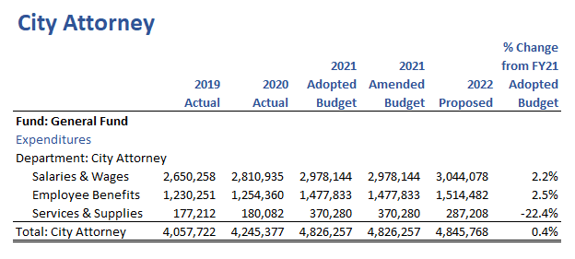
Financial Summary
Notes:
Decrease in services and supplies due to reduction of outside services – other related to contingency funds for outside counsel/subject matter experts.

Slide 53
Information Technology

Slide 54
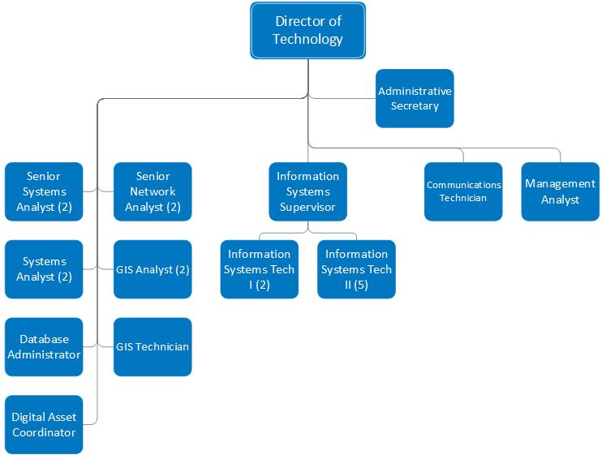
Information Technology (23 FTE)

Slide 55
Departmental Core Services
Centralized IT Services
    Business Systems Support, End-User Support & Desktop Applications, Public Safety Support, Cyber Security, Email, Phones, City Issued Device Management, Data Infrastructure
IT Project Management & Enterprise IT Services
    Business Process Review > Application Discovery > Acquisition > Implementation > Maintenance
    Server/Data Infrastructure Management (scalable/cost efficient)
    Routers, Switches, Firewalls, Internet/Intranet, Security
    Disaster Recovery/Backup Solution (Offsite)
Server/Data Infrastructure Management
    Scalable, Cost-efficient Virtualization, and Improved System Utilization

Slide 56
Top Accomplishments in FY20/21
Major Initiatives and Strategies for FY21/22
Top Accomplishments
  Enabled citywide work-from-home capability using Global Protect VPN client. Purchased, deployed & track laptops, webcams, cell phones & printers. Developed means to conduct virtual Council meetings, Municipal Court hearings & team collaboration.
  Implemented electronic document review to simplify project development. Put all building permit applications online & migrated permitting system to new hosted platform.
  Enhanced security camera systems throughout the city (parks, City Hall, Stead Treatment Plant). Deployed Automated License Plate Readers at four intersection and several police vehicles.
Major Initiatives & Strategies
  Secondary data center established to backup & mirror production center environment in case of primary system failure. (Organizational Effectiveness)
  Citywide GIS mapping portal for hosting data & applications to aid management in data driven decisions. (Organizational Effectiveness)
  Complete GSuite Shared Drives & OnBase Document Management Solution. Provides for more robust data storage, retention and records management functionality. (Organizational Effectiveness)

Slide 57
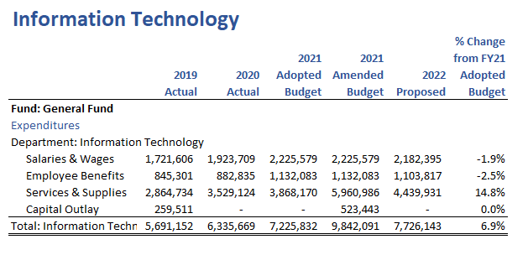
Financial Summary
Notes:
Supplies - Reflects the department submitted increases to os-other for new service levels and increased costs.

Slide 58
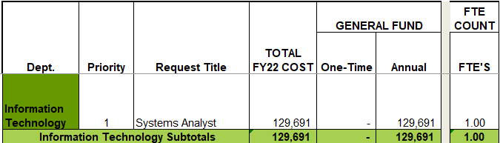
Additional Funding Requests

Slide 59
Neighborhood Services

Slide 60
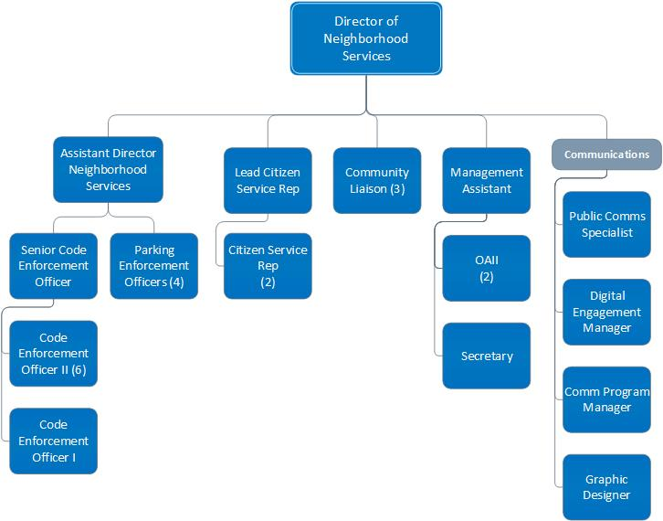
Neighborhood Services (28 FTE)

Slide 61
Departmental Core Services
Enforcement & Compliance
  Code Enforcement
  Parking
Communications & Community Engagement
  Reno Direct
  Community Liaisons
  Strategic Communications
  Digital Engagement
  Graphic Design

Slide 62
Top Accomplishments in FY20/21
Major Initiatives and Strategies for FY21/22
Top Accomplishments
  Department most impacted by pandemic response that had to assume leadership roles in regional response efforts through the Joint Information Center and Enforcement of Governor’s mitigations.
  Cross-department collaboration with Code Enforcement, Parking Enforcement and Reno Police Department to remove dilapidated/junk RV’s. Over 50 removed from streets in 2020.
  Implementation of new communications platforms (virtual media briefs, town halls and City Chat) to provide safe outreach and education along with focused support to vulnerable populations during COVID pandemic.
Major Initiatives and Strategies
  Increase support of COVID-19 pandemic mitigation, education and communication measures as transfer of authority occurs from State to Local jurisdictions. (Public Safety)
  Collaborate with city departments to mitigate increased nuisance activities on public and private properties throughout the city. (Public Safety, Homelessness, and Community Development)
  Develop, implement, and sustain standards of excellence for customer service and communication providing a positive and valuable experience for every resident, council, and staff interaction. (All Priorities)

Slide 63
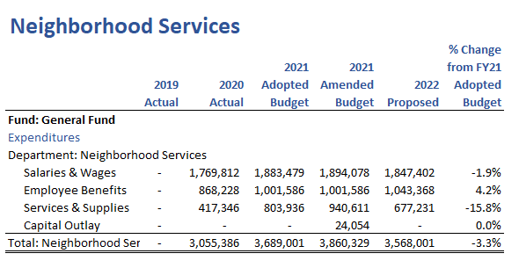
Financial Summary
Notes:
Decrease in services and supplies due to reduction in employee training and travel.

Slide 64
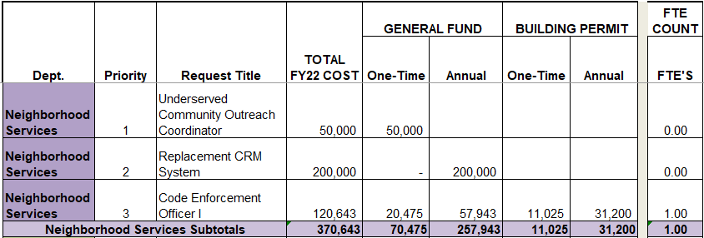
Additional Funding Requests

Slide 65
City Clerk

Slide 66
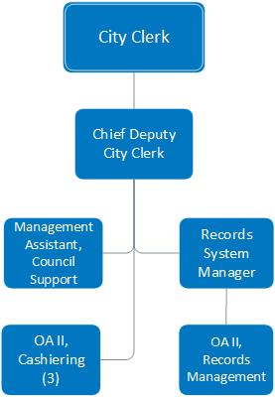
City Clerk (8 FTE)

Slide 67
Departmental Core Services
Council Support
  Council Meetings
  Resolutions, Ordinances, Contracts and Agreements
  Boards and Commissions
  Appeals
Central Cashiering
  All revenue, payments, general ledger entry
Records Management
  Public Record Requests
  Digitization and management of all City records
  Retention and destruction of all City records
  Policy management and training

Slide 68
Top Accomplishments in FY20/21
Major Initiatives and Strategies for FY21/22
Top Accomplishments
  Implementation of public search module, allowing citizens to access 10,000s of documents
  Retention schedule implementation
  Increased access to constituents during pandemic
Major Initiatives and Strategies
  OnBase conversion completed (Efficient and dependable business)
  50% digitization of all City records (Efficient and dependable business)
  Launch of public records platform (Efficient and dependable business)

Slide 69
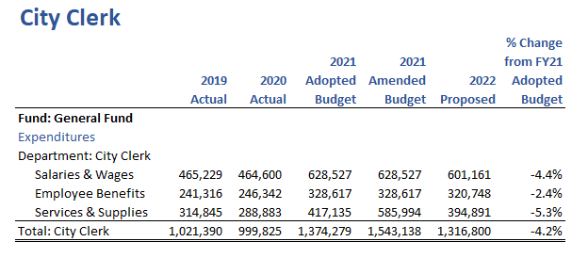
Financial Summary
Notes:
Salary and benefit reduction related to the adjustment of compensation for the Records Manager position from it’s FY21 budgeted amount to the recommended amount based on comp study.
Reduction in services and supplies is due to the lack of need for election funds in the upcoming fiscal year.

Slide 70
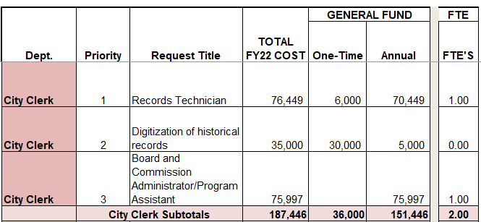
Additional Funding Requests

Slide 71
Civil Service

Slide 72
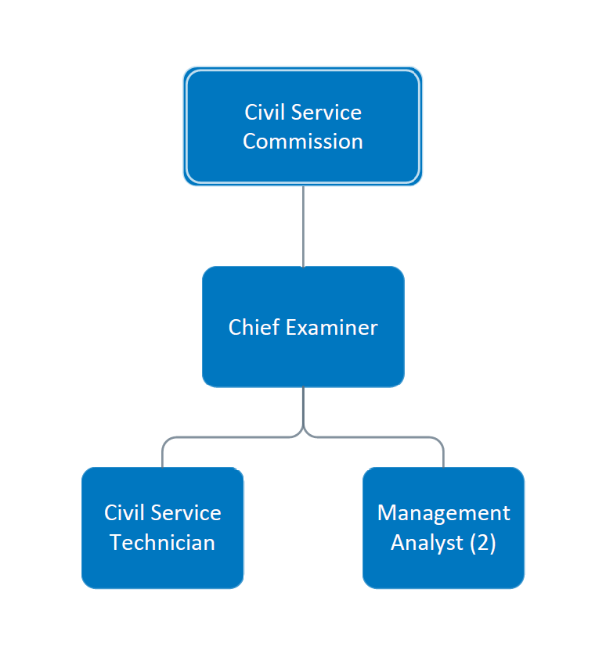
Civil Service (4 FTE)

Slide 73
Departmental Core Services
Workforce Panning and Development
  Recruitment
  Examination
  Employee Administrative Complaint/Disciplinary Hearings
  Lines of Progression, Promotional Opportunities, and Post Assessment Counseling Reviews
  Record and Provide Civil Service Commission Information to the Public
  Education and Outreach

Slide 74
Top Accomplishments in FY20/21
Major Initiatives and Strategies for FY21/22
Top Accomplishments
  The Civil Service Commission approved and adopted several rule changes and updates. These included the addition of non-career appointments, gender neutral language updates and transparent language for protests.
  Introduced new assessment technology. These new additions provided platforms for remote proctored and un-proctored testing, expansion of computer based testing and item bank for test development.
  A continuous testing recruiting and testing process was piloted for the entry level Firefighter position with positive results.
Major Initiatives and Strategies
  The department plans to focus on Diversity by working collaboratively on employer branding, broadening recruitment reach through expanded remote testing opportunities and engaging more actively with the community. (Organizational Effectiveness/Public Safety)
  Internal policy and process improvements will remain a priority with continued rule review and updates, standardization and development of staff. (Organizational Effectiveness)
  Enhancing customer service is critical to our success so we will be focusing on customer satisfaction surveys to identify areas of improvement. (Organizational Effectiveness)

Slide 75
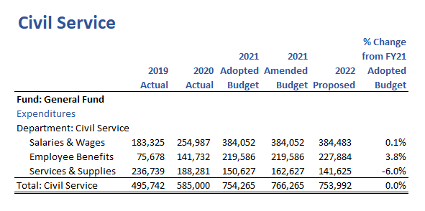
Financial Summary
Notes:
S&S - Department submitted reductions

Slide 76
Finance

Slide 77
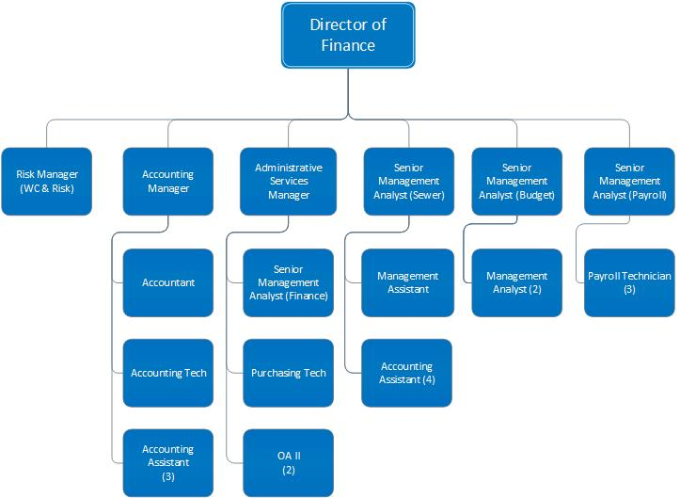
Finance (26 FTE)

Slide 78
Departmental Core Services
Accounting
Budgeting
Financial Planning
Organizational Support
Fiscal Analysis & Support
Payroll
Sewer Billing

Slide 79
Top Accomplishments in FY20/21
Major Initiatives and Strategies for FY21/22
Top Accomplishments
  Provided monthly financial updates and increased financial transparency to Council and Labor Groups
  Developed Public Safety Center and Moana Pool finance plan
  Disbursed funds and supported programs utilizing $46.7 million in CARES Act funding
Major Initiatives and Strategies
  Develop a plan and provide policy changes necessary to move the City toward a Resilient Budget (Fiscal Sustainability)
  Restructuring of the City’s Sewer bond portfolio to maintain long-term stability of improvements if financially advantageous to the City’s debt position (Fiscal Sustainability)
  Implementing a new budget software which will allow for restructuring of the budget and capital improvement plan development (Fiscal Sustainability)

Slide 80
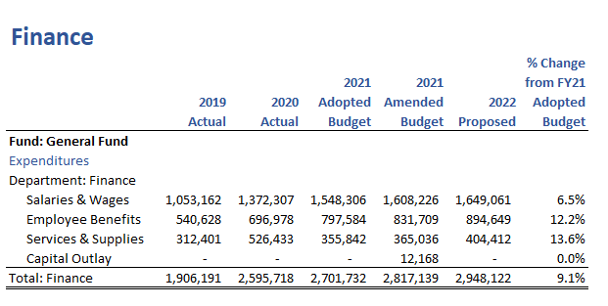
Financial Summary
Notes:
Increase in salaries and benefits due to the addition of a Payroll Tech mid year 2020 with IAFF Labor Contract approval
Increase in services and supplies due to increase in investment fees, which are offset by investment income.

Slide 81
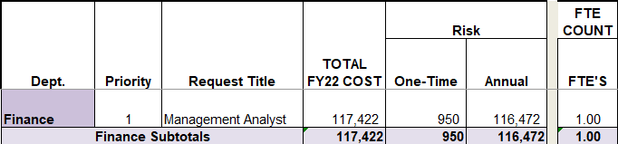
Additional Funding Requests

Slide 82
Human Resources

Slide 83
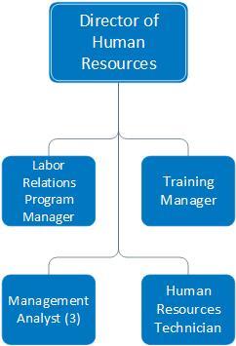
Human Resources (7 FTE)

Slide 84
Departmental Core Services
Employee Services
  Employee and Labor Relations
  Workforce Planning and Development
Workers’ Compensation

Slide 85
Top Accomplishments in FY20/21
Major Initiatives and Strategies for FY21/22
Top Accomplishments
  Management and implementation of COVID-19 policies, procedures, laws, rules, and regulations, including the Families First Coronavirus Response Act.
  Rigorous group health plan management. Continued implementation of a retiree group health insurance program saving the City significant claims costs for retirees over the age of 65.
  Fire and Police Academy during COVID-19 pandemic.
Major Initiatives and Strategies
  Continue to successfully negotiate with employee bargaining groups. (Governance and Organizational Effectiveness)
  Continued management of COVID-19 policies and procedures. (Governance and Organizational Effectiveness)
  Define, document, update, and train for citywide and departmental policies at every level. (Governance and Organizational Effectiveness)

Slide 86
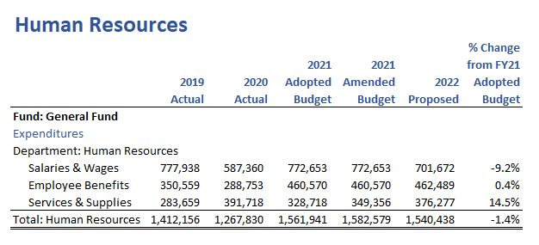
Financial Summary
Notes:
Salaries - Salary decrease due to turnover
S&S - CM directed $50K increase to OS-other

Slide 87
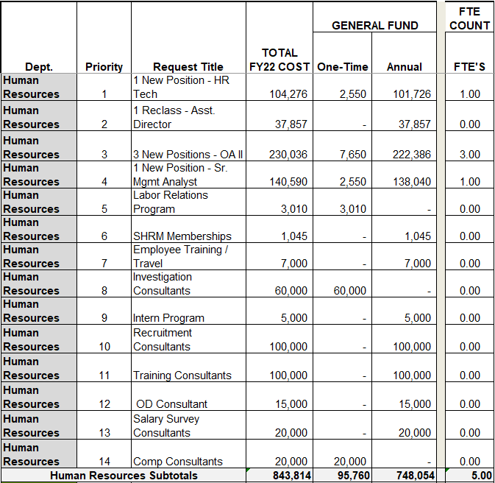
Additional Funding Requests

