Slide 1
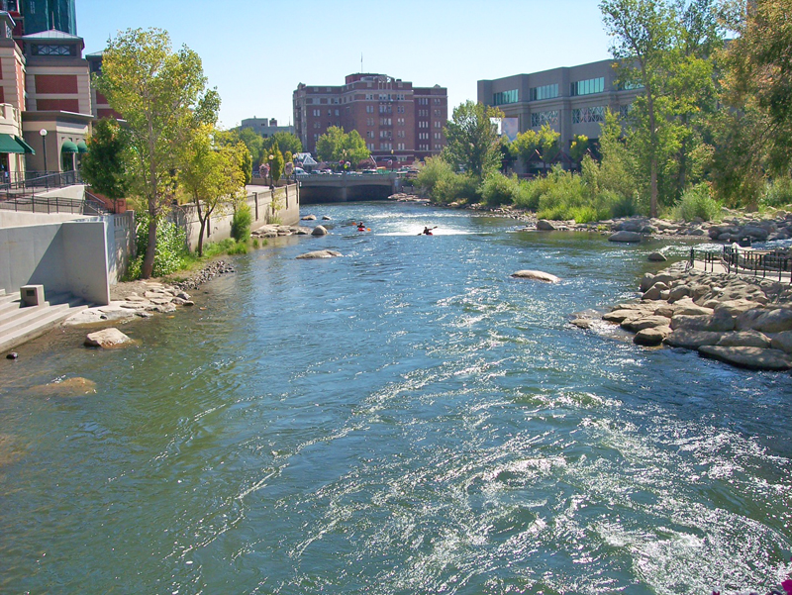
City of Reno Council Workshop
April 5, 2018

Slide 2
April 5, 2018 Agenda:
Department Budget Discussions (Cont’d)
  Core Services
  Strategic Plans and Program Change Requests
Council Budget Priorities for FY 18/19

Slide 3
FY 18/19 Preliminary Budget
Budget status reminder from February 21, 2018 Workshop:
FY 2018-19 Preliminary Budget has a shortfall of $5.5 Million

Slide 4
Department Core Services and Strategic Plans (Cont’d)

Slide 5
Department Presentations
Communications & Community Engagement
Civil Service
Community Development
Department of Information Technology
Finance Department

Slide 6
Department Presentations (Cont.)
Human Resources
Municipal Court
City Clerk
City Manager
City Attorney

Slide 7

FY 18/19
COUNCIL BUDGET
WORKSHOP
OFFICE OF COMMUNICATIONS AND COMMUNITY ENGAGEMENT(OCCE)

Slide 8
Departmental Core Services
  Support the City of Reno’s Vision, Mission and Strategic Priorities by:
    Informing and engaging citizens, employees, media, and Mayor/City Council
    Ensuring responsive communication
    Enhancing City services through community input
    Building trust through increased transparency

Slide 9

Departmental Core services (CONT’D)
Community
Strategic
Communications
Digital
Engagement
Mayor
and
Council
Employees
Reno
Direct
Community
Engagement
Media

Slide 10
Department Strategic Plan
  Enhance and improve two-way communications with target audiences:
    Maintain and measure effectiveness of current communications tools
    Secure innovative, effective and cost-efficient communications tools to engage and inform target audiences with a focus on diversity and inclusion
    Enhance and improve media relations through the use of proactive outreach and messaging
    Develop programs that increase transparency, interest and participation in City of Reno activities
    Enhance and improve internal communications and build organizational pride among employees
    Develop media training opportunities Citywide

Slide 11
FY 18/19
COUNCIL BUDGET WORKSHOP
CIVIL SERVICE COMMISSION

Slide 12
Departmental Core Services
The City of Reno Office of the Civil Service Commission (CSC) was mandated by the Nevada State Legislature in the Reno City Charter to be an autonomous body that oversees a merit system of competition.
The mission of the CSC is to provide an efficient workforce for the City of Reno.
The cornerstone of the City’s employment program is equity and fairness.
Employment with the City of Reno is accomplished through an individual’s demonstration of merit and fitness for the job in which an individual seeks to be employed.
The current CSC staff allocation of three (3) is responsible for recruiting, attracting, testing and presenting for selection the majority (approximately 93%) of the approximately 1200+ “regular” employees in the City’s total regular workforce

Slide 13
Departmental Core Services (CONT’D)
  Recruitment
  Outreach
  Job Posting
  Job Analysis
  Test Design and Administration
  Establish Eligibility Lists
    New hires
    Promotionals
  Administer the CSC Meetings

Slide 14
Department Strategic Plan
  PRIMARY GOALS:
  Innovate and update recruiting, outreach and testing and selection processes to:
    Benchmark and implement best practices towards that goal
    Reduce requisition to hire time
    Attract and maintain the best employees in a changing labor pool
    Provide more flexibility in hiring employees
    Present the best and most qualified candidates for departments to hire and promote
    Maintain fairness and equity in processes and procedures
    Collaborate with departments to review CSC rules to identify and streamline processes to be competitive in our labor force
    Provide outreach to the community about opportunities with the City
    Support the City’s Diversity Plan
  Present eligibility lists quarterly to fully staff Dispatcher positions by the end of the calendar year (this has not been done since the 1990’s)
  Provide education and training on CSC services, processes and procedures

Slide 15
FY 18/19
COUNCIL BUDGET WORKSHOP
COMMUNITY DEVELOPMENT

Slide 16
Departmental Core services
  State of the Community Development Dept
  Average multi-family rents in Reno region increased 12.68% in 2016, and 10.7% in 2017; almost 25% in 2 years.
  Unemployment averaged 4.1% in 2017, and multifamily residential vacancy averaged 3.8%.
  Building and Safety issued permits for 1,150 SF dwellings and 1,160 multi-family units in 2017.

Slide 17
Departmental Core services
  State of the Community Development Dept
  Engineering Division will process an estimated 1500 single family lots on final maps by end of FY 2018.
  Each Code Enforcement Officer processed an average of 813 cases in 2017 – an increase of 47% over the last 5 years.
Emergency Shelter served over 2300 unique individuals in 2017

Slide 18
Departmental Core services
  Building and Safety Division:
  Responsible for plan review, permitting, and the enforcement of building codes and standards
  Strives to provide professional, efficient, and accurate services to developers, building professionals and citizens

Slide 19
Departmental Core services (CONT’D)
  Business Licensing Division:
  Protect the public by assuring that businesses operate in a safe and appropriate manner
  Collect revenues to fund Police, Fire, and other public services.

Slide 20
Departmental Core services (CONT’D)
  Code Enforcement Division:
  Assure that citizens, businesses, and all others residing or operating in the City abide by the rules adopted by the City Council
  Frequently team with police, fire, Washoe County mental health, and other agencies on complex, multi-faceted issues, such as the cleanup of unlawful encampments
  Inspect and assure compliance with all special use permit conditions

Slide 21
Departmental Core services (CONT’D)
  Engineering Division:
  Reviews and inspects proposed building permits, maps, subdivisions, and other entitlements to ensure that they are designed and constructed to City standards
  Monitors the Engineer of Record and Materials Testing programs
  Inspection of all storm water pollution prevention plans associated with construction projects over an acre in size

Slide 22
Departmental Core services (CONT’D)
  Housing & Neighborhood Development:
  Affordable housing, homelessness care and prevention, and enhancing accessibility
  Administer federal grant programs, primarily from the U.S. Department of Housing and Urban Development
  Continuum – from “off the streets” to permanent housing

Slide 23
Departmental Core services (CONT’D)
  Planning Division:
  Engage citizens and other stakeholders in establishing a community vision through public workshops, neighborhood advisory boards, visioning exercises, and related activities
  Implement the community vision through the City of Reno Master Plan, zoning ordinance, and other regulations

Slide 24
Department Strategic plan
  PRIMARY DEPARTMENT GOALS:
  Administration Goals:
  Improve customer service
  Improve all application processing efficiencies (planning, engineering, business license, building permits)
  Continue the Drop In with CD, Community Development Conversations, and Department newsletter programs

Slide 25
Department Strategic plan (CONT’D)
  Building and Safety Goals:
Regional adoption and implementation of the 2018 International Codes, ensuring consistency across northern Nevada jurisdictions
Development of an Interlocal Agreement with Washoe County District Health for 10-day plan review of Reno building permits that are properly submitted
Increase by 10% the number of contractors and builders with ACA accounts for online scheduling, and cross-training employees in division on permit intake

Slide 26
Department Strategic plan (CONT’D)
  Building and Safety Goals (cont’d):
Develop fully integrated, customer-initiated online permit application by January 2019
Establish policy for transition to mandatory electronic submittal of all commercial plans by January 2020
Establish policy for transition to mandatory electronic submittal of all residential plans by January 2021

Slide 27
Department Strategic plan (CONT’D)
  Building and Safety Facts
Year over year changes (2017 to 2018 Estimate):
  Building permits: 9,000 to 10,500 (16.7% Increase)
  Inspections: 52,000 to 61,000 (17.3% Increase)
CY 2017 New Construction Permits Issued:
  1150 Single-Family Dwellings
  1160 Multi-Family Units

Slide 28
Department Strategic plan (CONT’D)
Business License Goals:
Refine the license renewal and amendment process in the new Accela Civic platform to improve efficiencies for staff and customers
Integration of the Secretary of State Business Licensing platform SilverFlume with the new Accela Civic platform to streamline the licensing process
Continue public outreach to educate customers on how to migrate and utilize the regional online licensing and permits portal, ONENV.US, to conduct business online

Slide 29
Department Strategic plan (CONT’D)
Business License Facts:
Renewed 20,433 license applications FY16/17, estimate 21,900 licenses FY17/18 (10.7% increase)
Processed 3,128 new license applications FY16/17, estimate 3,700 new license applications FY17/18 (11.8% increase)

Slide 30
Department Strategic plan (CONT’D)
Code Enforcement Goals
Implement new motel inspection program with minimum standards for single room occupancies
Re-establish public education program to prevent code violations, include attending Neighborhood Advisory Board meetings on a regular basis
Continue to address homeless camp cleanup and related issues

Slide 31
Department Strategic plan (CONT’D)
Code Enforcement Facts
92% of cases are responses to external customers (Reno Direct) / 8% of cases are internally generated
Average annual cases per officer have increased from 552 to 813 since 2012 (47% increase)

Slide 32
Department Strategic plan (CONT’D)
Engineering Goals:
More efficient review of proposed subdivisions and more thorough inspections of infrastructure
Implement and provide ongoing support to quality assurance and SWPPP programs
Improve engineering application review efficiencies

Slide 33
Department Strategic plan (CONT’D)
Engineering Facts:
1,127 single family residential parcels recorded in FY 2017
900 single family residential parcels recorded at end of February FY 2018; estimate 1,500 end of FY 2018

Slide 34
Department Strategic plan (CONT’D)
Housing and Neighborhood Development Goals:
Maintain high standards for regulatory and program requirements
Continue to develop and maintain good relations with HUD and other funding groups
Maintain a balance between effectiveness and compliance in the programs managed as rules and regulations are being revised

Slide 35
Department Strategic plan (CONT’D)
Housing and Neighborhood Development Facts:
Emergency Shelter served over 2300 unique individuals last FY
Number of overflow beds have increased by 95% (went from 100 overflow to 195)
Deposit Assistance Program will serve 500+ households in FY 18

Slide 36
Department Strategic plan (CONT’D)
Housing and Neighborhood Development Facts (cont’d):
Rapid Re-Housing serves 40+ households annually
Reno Works will graduate it’s 9th session (60 people!)
Neighborhood Renewal Program (blight fund) has rehabbed 7 houses to date
Motels to Homes has successfully housed 60+ families to date

Slide 37
Department Strategic plan (CONT’D)
Planning Goals:
Support historic preservation
Enhanced focus on community outreach
Process a comprehensive revision of RMC Title 18 and update the City annexation policy plan
Improve service efficiencies

Slide 38
Department Strategic plan (CONT’D)
Planning Facts:
In the last three years, the Planning Division processed:
  83 LDC’s (Land Development Cases) in FY16
  72 LDC’s in FY17
  58 LDC’s as of end of Feb FY18; Est. 85 LDC’s total
  StoneGate PUD Ordinance and Handbook (5,000+ Units)
  ReImagine Reno Masterplan

Slide 39
FY 18/19
COUNCIL BUDGET
WORKSHOP
DEPARTMENT OF INFORMATION TECHNOLOGY

Slide 40
Departmental Core Services
  Centralized IT Services
    Email, Desktop Support, Phones, City Issued Device Management, Etc.
  IT Project Management & Enterprise IT Services
    Application Discovery -> Acquisition -> Implementation -> Maintenance -> Review
  Network Infrastructure Management
    Routers, switches, firewalls, Internet/Intranet, Security
  Server/Data Infrastructure Management
    Scalable, cost-efficient and improved system utilization

Slide 41
Departmental Core Services (CONT’D)
  Departmental + IT Partnerships
    Police – BWC, Field Reports, Mobile Tools, Security Cameras
    Fire – Data quality and Field Reporting
    Dispatch – Computer Aided Dispatch
    Finance – Financial and Budgeting System
    HR – Onboarding, Building Access System Badges, Payroll
    City Clerk – Records retention and Public Requests
    CD – Robust mobile tools, Building permits, GIS
    PW – Parking Ticketing App, SCADA, Mobile Devices for field personnel, Building Maintenance System, Asset Management
    CMO - Big Data Aggregation, Policy Driven Dashboards and Open Data Portals, Security System
    Regional Partnerships – Smart City Initiatives, Interfaces to transfer data between agencies, Public Safety Systems/Applications

Slide 42
Department Strategic Plan
  PRIMARY GOALS OF SERVICES:
    IT Availability
    IT Invisibility
    IT Responsibility
    IT Efficiency
  PRIMARY GOALS OF INFRASTRUCTURE:
    Robust infrastructure of networks and servers
    Continuity of Services
    Cybersecurity
    Capacity Growth

Slide 43
FY 18/19
COUNCIL BUDGET
WORKSHOP
FINANCE DEPARTMENT

Slide 44
Departmental Core services
  Accounting
  Operational accounting and financial services
    Compliance with GASB, policies & procedures, etc.
    Management of debt portfolio
    All accounting-related activities
  Budgeting
  Oversight and management of budget for all funds and accounts
  Provide budget, fiscal and general issue analysis
  Financial Planning
  Overall financial reporting and financial updates
  Manage investment portfolio
  Organizational Support
  Procurement
  City mail
  Sewer Billing
  Maintenance of an effective and efficient sewer billing process

Slide 45
Department Strategic plan
  PRIMARY GOALS:
    Research potential restructuring of the Redevelopment Agency Bonds
    Monitor all debt service
      Initiate restructuring when economically feasible, including preparation of annual debt management report and updated policy.
    Monitor economic conditions with constant review of revenues and expenditures
      Review and update Budget Guiding Principles
    Continue enhanced collection efforts in all areas
      Sewer billing, parking tickets, code enforcement, etc.

Slide 46
FY 18/19
COUNCIL BUDGET WORKSHOP
HUMAN RESOURCES

Slide 47
Departmental Core Services
  Recruitment & Development Program
  Employee Services Program
  Employee & Labor Relations Program
  Compliance Program

Slide 48
Department Strategic Plan
  FUTURE GOALS:
    To build a robust and meaningful Learning & Development Program for the City of Reno
    To analyze, identify, and maximize efficiencies in all program areas
    To facilitate organizational culture change through inter-Departmental collaboration

Slide 49
FY 18/19
COUNCIL BUDGET WORKSHOP
MUNICIPAL COURT

Slide 50
Departmental Core Services
Reno Municipal Court (RMC) is a busy 4 judge limited jurisdiction court, supported by 46 highly-skilled professionals, processing almost 20,000 cases each year and maintaining several unique specialty court programs.
The Court is an adult court of record, established by Chapter 5 of the Nevada Revised Statutes and adopted by the City of Reno Municipal Charter.
RMC’s core services are to impartially adjudicate misdemeanor crimes and code violations, provide supervised rehabilitation services to those needing treatment, operate in a cost-effective manner, provide safe and equal access to justice to all court users, maintain the integrity and independence of the judiciary, and preserve the confidence and respect of those coming before the Bench.

Slide 51
Department Strategic Plan
  PRIMARY GOAL 1: MAINTAIN A MODEL COURT ENVIRONMENT
  Continue to provide quality customer service both at the courthouse and online
    Developed a new check-in and payment process that opens 8 windows during peak times
  Continue to make operational changes, such as introducing new technology, without impacting the court’s calendar, performance or budget
    Text notification of upcoming hearing and payment due dates
  Continue to strengthen community relationships by working closely with city management, holding kids court, adopting a local school, making presentations at high schools and participating in special events
    Participated in the State of the City – Department Showcase

Slide 52
Department Strategic Plan (CONT’D)
PRIMARY GOAL 2: EXPAND THE USE OF TECHNOLOGY
  Continue to audit all active cases and workflows to ensure efficiencies and compliance to state and federal laws as well as Supreme Court mandates
    RMC was the first court in the State to have it’s case management system certified by the Nevada Supreme Court
  Continue to advance the Electronic Case File project
    Research and implement new electronic features, such as digital signatures and file stamps
  Continue to upgrade the Court’s recently redesign website
      Easy to navigate to primary areas of interest, such as online payments
      and select your own traffic arraignment date
  Fully utilize the Court’s recently installed digital signage
      Helps to direct foot traffic and provides real-time information

Slide 53
Department Strategic Plan (CONT’D)
PRIMARY GOAL 3: GROW SPECIALTY COURT PROGRAMS
  Effectively utilize a limited budget to serve the growing population of specialty court participants
    6 programs, 261 participants, 82 graduates last year
  Continue to identify new strategies to support specialty court participants
    Assist with housing placement, job training, and life-skills workshops
    Mobile breathalyzers
  RMC is one of only a few courts throughout the nation selected to receive federal training in veteran’s treatment strategies
      RMC is planning to pilot a Veteran’s Court in the fall of this year
  Continued to support Project Homeless Connect
      Court is conducted offsite, usually at the homeless shelter or Reno Event Center

Slide 54
FY 18/19
COUNCIL BUDGET
WORKSHOP
CITY CLERK

Slide 55
Departmental Core Services
COUNCIL SUPPORT
  Maintain official record, journal, laws, minutes and proceedings all of Council Meeting
  Boards and Commissions
CENTRAL CASHIERING
  All payments
  Parking Permit Program Administration
RECORDS MANAGEMENT
  Public Records
  Document and retention management

Slide 56
Department Strategic Plan
  PRIMARY GOALS:
  Electronic Records
  Federal, State, and Local law adherence
  Customer Service
  DMV Holds
  Continued Efficiencies

Slide 57
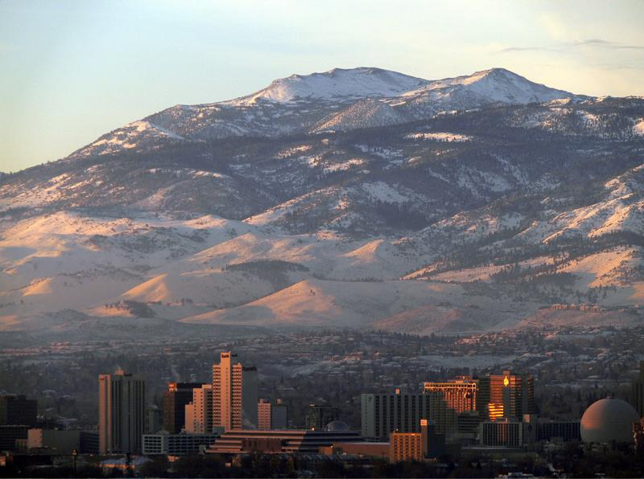
FY 18/19
COUNCIL BUDGET
WORKSHOP
CITY MANAGER

Slide 58
DEPARTMENTAL CORE SERVICES
Departmental Core Services
Administration
  Senior Management & Administration
  Citywide Strategic Planning Efforts
  Coordination & Support
Intergovernmental Relations
  Lobbying
  Regional Coordination
  Federal Legislative Program
  Special Projects

Slide 59
DEPARTMENTAL CORE SERVICES
Departmental Core Services (CONT’D)
Office of Arts, Culture & Special Events
  Public Art
    Public Art Program
    Arts and Culture Commission
Office of Arts, Culture & Special Events
  Special Events
    Permitting & Coordination
    Special Events Sponsorship Program
    Reno City Council Special Events Subcommittee
    Grant and Sponsorship
    Programs

Slide 60
DEPARTMENTAL CORE SERVICES
Departmental Core services (CONT’D)
Office of Economic Development
  Business Development
  Redevelopment
  Downtown Revitalization
Sustainability
  ReLeaf & ReEnergize Programs
  Strategic Sustainability & Climate Action Plan
  Collaboration & Engagement

Slide 61
DEPARTMENT STRATEGIC PLAN
Department Strategic Plan
  PRIMARY GOALS:
    Update, improve, and train employees on City policies and procedures.
    Further strategic planning throughout organization.
    Improve performance management and data-driven decision making.
    Support process improvement, streamlining efforts, innovation, and best practices.
    Continue focus on developing a positive and professional organizational culture.

Slide 62
DEPARTMENT STRATEGIC PLAN
Department Strategic Plan (CONT’D)
  PRIMARY GOALS:
    Develop Federal and State legislative platforms.
    Maintain our role as a leader in arts, culture, and special events.
    Ensure success of Downtown Management Organization and Business Improvement District.
    Work with regional and community partners to expand programs that reduce climate pollution.

Slide 63
FY 18/19
COUNCIL BUDGET
WORKSHOP
CITY ATTORNEY’S OFFICE

Slide 64
Departmental Core Services
The City Attorney’s Office (“CAO”) provides a full range of legal services to the City of Reno, including legal advice and counsel, civil litigation, criminal prosecution and risk management. The CAO consists of three divisions:
  Civil Division - Provides readily accessible, cost effective, high quality legal advice and counsel to City Council and staff.
  Criminal Division - Achieves justice through effective prosecution of misdemeanor offenses.
  Risk Division - Minimizes losses and costs related to property and liability claims through proactive and effective risk management.
  As part of each division’s mission, the CAO emphasizes staff development, training, education and the practice of preventative law.

Slide 65
Departmental Strategic Plan
Civil Division
  Reno Municipal Code Update
    General procedures
    Appeals
    Adult business regulations
    Sign code
    Affordable housing
  Litigation
    Employment and Labor
    Civil rights
    North Valley Flooding
    Adult business regulations
    Sign code
    Solid waste litigation
Criminal Division
  Aggressive prosecution of driving while under the influence (DUI) cases.
  Aggressive prosecution of domestic violence cases.
  Aggressive prosecution graffiti and nuisance cases.
  Specialty courts
Risk Division
  Minimizes losses and costs related to property and liability claims

Slide 66
Council Budget Priorities

Slide 67
Council Budget Priorities
Discussion regarding Council’s budget priorities for FY 2018-19
Next Steps
  April 15 – Tentative City Budget due to State
  1st and 2nd weeks May – Council Budget Workshops (including public engagement)
  May 23 – Public Hearing & Budget Adoption
  June 1 – Budget due to State

Slide 68
FY 18/19
Other Funds
(Additional Information at May Workshop)

Slide 69
Summary of FY 18/19 Revenues & Expenses
(excluding General Fund)

Slide 70
FY 18/19
Capital Improvement Plan (CIP)
(Additional Information at May Workshop)

Slide 71
FY 18/19 Capital Improvement Plan (CIP)
The Capital Improvement Plan guides the construction and major maintenance of City facilities and infrastructure.
Constitutes a critical component in the City’s system of planning, monitoring, and managing municipal activities.
Links together in a single process the annual cycle of planning, budgeting, implementation, and quality assessment activities.
CIP Committee met in February to review FY 18/19 projects and provide recommendations for projects to be funded.

Slide 72
Capital Improvement Plan by Fund

Slide 73
FY 18/19 Capital Improvement Plan (CIP)
Funding Source: City Capital Projects Fund (Fund 30000) is funded via a General Fund Transfer. Of all the CIP funds, this is the least restrictive, and thus gets the most competition for projects.

Slide 74
FY 18/19 Capital Improvement Plan (CIP)
Funding Source: CDBG Entitlement Grant for the Department of Housing and Urban Development (HUD)

Slide 75
Questions?

Slide 76
Additional Slides

Slide 77
Follow-up items from February 21st & February 23rd Council Budget Workshops

Slide 78
Follow-up items from February
Council Workshops:
FY 18/19 Preliminary Budget
Budget Assumptions for FY18/19
Summary of Revenues & Expenses
Fee Structure
Room Tax

Slide 79
Budget Assumptions for FY 18/19
*Proposed reduction to 0%

Slide 80
Summary of FY 18/19 Revenues & Expenses
(excluding General Fund)

Slide 81
Fee Structure
Opportunities for Additional Revenues Through Fee Adjustments
  Fees vs Taxes
    Most of the City fees are based on the cost for providing the related service (increased by CPI).
    Business License fees are taxes, so not tied to cost
      NRS sets a statutory cap on the amount of business license fees collected each year
        Fees as a percentage of gross revenue may only increase by approximately $500,000
        Flat fees may increase by approx. $8 million
  Staff will analyze fees/taxes for potential increases

Slide 82
FY 18/19 Room Tax Fund Council
 | Notes | FY17/18 Estimated | FY 18/19 Requested
Room Taxes |  | $1,200,000 | $1,200,000
Miscellaneous |  | $11,500 | $5,000
Beginning Fund Balance |  | $1,002,991 | $393,695
Total Resources |  | $2,214,491 | $1,598,695
Pioneer Center |  | $50,960 | $50,960
KTMB |  | $15,000 | $15,000
Arts Commission | Includes prior year carry forward | $284,271 | $205,406
Administrative Costs |  | $13,770 | $19,244
Special Events Support |  | $530,736 | $545,212
Artown Support | Includes prior year carry forward | $135,000 | $125,000
Art in Public Places | Includes prior year carry forward | $299,178 | $50,000
Sternberg Poles |  | $100,000 | $100,000
Jack Tighe Parking Lot |  | $200,000 | $0
Downtown Lamp Replace | Includes prior year carry forward | $4,381 | $0
DMO |  | $187,500 | $0
Amtrak ADA Restroom |  |  | $120,000
Recommended Reserve |  |  | $307,705
Remaining Fund Balance |  | $393,695 | $60,168
Total Expenditures |  | $2,214,491 | $1,598,695
Notes:
Admin cost are for risk and indirect costs
Special Events support includes 1 position at $157,915

Slide 83
FY18/19 Room Tax Fund PRCS
 | FY17/18 Estimated | FY 18/19 Requested
Room Taxes | $1,200,000 | $1,200,000
Miscellaneous | $0 | $0
Beginning Fund Balance | $491,288 | $336,177
Total Resources | $1,691,288 | $1,536,177
Irrigation System Technician | $96,652 | $84,876
Additional Mowing | $30,000 | $30,000
Park Camera’s | $92,820 | $0
Parks Support | $935,639 | $973,348
Idlewild Pool | $200,000 | $0
Recommended Reserve |  | $272,056
Remaining Fund Balance | $336,177 | $175,897
Total Expenditures | $1,691,288 | $1,536,177

