Slide 1
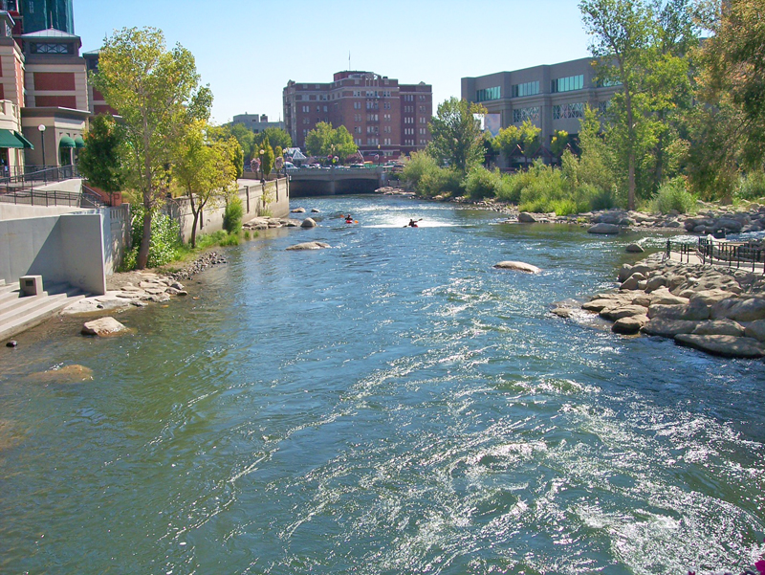
City of Reno Council Workshop
Finance
February 23, 2018

Slide 2
February 23, 2018 Agenda:
Follow-up items from February 21st Council Workshop
Department Budget Discussions
  Core Services
  Strategic Plans and Program Change Requests
Council Budget Priorities for FY 18/19

Slide 3
Follow-up items from February 21st Council Budget Workshop

Slide 4
Follow-up items from February 21
Council Workshop:
FY 18/19 Preliminary Budget
Budget Assumptions for FY18/19
Summary of Revenues & Expenses
Fee Structure
Room Tax

Slide 5
FY 18/19 Preliminary Budget
Budget status reminder from February 21, 2018 Workshop:

Slide 6
Budget Assumptions for FY 18/19

Slide 7
Summary of FY 18/19 Revenues & Expenses
(excluding General Fund)

Slide 8
Fee Structure
Opportunities for Additional Revenues Through Fee Adjustments
  Fees vs Taxes
    Most of the City fees are based on the cost for providing the related service (increased by CPI).
    Business License fees are taxes, not tied to cost
      NRS sets a statutory cap on the amount of business license fees collected each year
        Percentage of gross revenue cap availability of approximately $500,000
        Flat fee cap availability of approximately $8 million
  Staff will analyze fees/taxes for potential increases

Slide 9
FY 18/19 Room Tax Fund Council
 | Notes | FY17/18 Estimated | FY 18/19 Requested
Room Taxes |  | $1,200,000 | $1,200,000
Miscellaneous |  | $11,500 | $5,000
Beginning Fund Balance |  | $1,002,991 | $393,695
Total Resources |  | $2,214,491 | $1,598,695
Pioneer Center |  | $50,960 | $50,960
KTMB |  | $15,000 | $15,000
Arts Commission | Includes prior year carry forward | $284,271 | $205,406
Administrative Costs |  | $13,770 | $19,244
Special Events Support |  | $530,736 | $545,212
Artown Support | Includes prior year carry forward | $135,000 | $125,000
Art in Public Places | Includes prior year carry forward | $299,178 | $50,000
Sternberg Poles |  | $100,000 | $100,000
Jack Tighe Parking Lot |  | $200,000 | $0
Downtown Lamp Replace | Includes prior year carry forward | $4,381 | $0
DMO |  | $187,500 | $0
Amtrak ADA Restroom |  |  | $120,000
Recommended Reserve |  |  | $307,705
Remaining Fund Balance |  | $393,695 | $60,168
Total Expenditures |  | $2,214,491 | $1,598,695
Notes:
Admin cost are for risk and indirect costs
Special Events support includes 1 position at $157,915

Slide 10
FY18/19 Room Tax Fund PRCS
 | FY17/18 Estimated | FY 18/19 Requested
Room Taxes | $1,200,000 | $1,200,000
Miscellaneous | $0 | $0
Beginning Fund Balance | $491,288 | $336,177
Total Resources | $1,691,288 | $1,536,177
Irrigation System Technician | $96,652 | $84,876
Additional Mowing | $30,000 | $30,000
Park Camera’s | $92,820 | $0
Parks Support | $935,639 | $973,348
Idlewild Pool | $200,000 | $0
Recommended Reserve |  | $272,056
Remaining Fund Balance | $336,177 | $175,897
Total Expenditures | $1,691,288 | $1,536,177

Slide 11
Department Core Services and Strategic Plans

Slide 12
Department Presentations
Police Department
  Public Safety Dispatch
Fire Department
Public Works
Civil Service
Communications & Community Engagement
Community Development
Department of Information Technology

Slide 13
Department Presentations (Cont.)
Finance Department
Human Resources
Municipal Court
Parks, Recreation & Community Services
City Clerk
City Manager
City Attorney

Slide 14
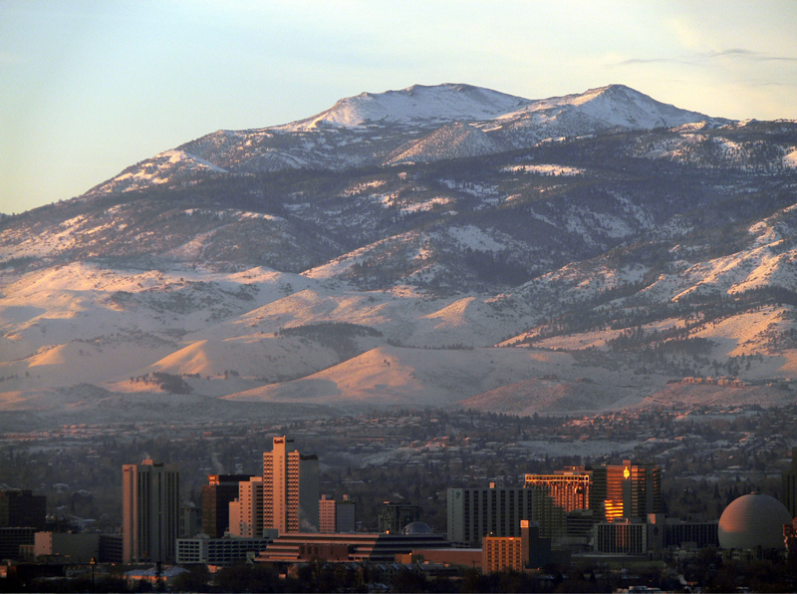
FY 18/19
COUNCIL BUDGET WORKSHOP
RENO POLICE DEPARTMENT

Slide 15
Departmental Core Services
    Partner with our community to create a safe city by providing the highest level of police services
      Responding to calls for service in a prompt and courteous manner
      Implementing intelligence led policing practices to solve crimes
      Adequately train newly hired officers
      Evaluate effective deployment of police resources
      Limit gang related crime through aggressive law enforcement efforts

Slide 16
Departmental Core Services (CONT’D)
      Provide a high visibility law enforcement presence in the downtown area
      Thorough investigation of crimes resulting in apprehension of offenders and recovery of stolen property
      Traffic law enforcement and public education to reduce property damage, injuries, and deaths associated with traffic crashes
      Plan, administer, and coordinate the resources necessary to ensure cost effective and efficient provisions to the department
      Provide the highest level of victim-centered services and resources through the Victim Services Unit
      Partnerships with volunteer organizations provides additional resources at no cost to the city. (360 Blueprint, TIP, SAVE, Faith-based groups)

Slide 17
Department Strategic Plan
  PRIMARY GOALS:
    Increase efficiency of on-line reporting
    Re-organization of dispatch services under the police department purview
    Mandatory body camera deployment
    Addressing challenges posed by annexation and population increase

Slide 18
Department Strategic Plan (CONT’D)
  Opportunities:
    Increase in resource allocation to homelessness
    Re-Organization of executive staff to strengthen the department vision
    Increased demand for traffic enforcement at high crash locations and unsafe pedestrian walkways, while working with limited personnel
    Additional workload on patrol officers, detectives, and support staff with legalization of marijuana

Slide 19
FY 18/19
COUNCIL BUDGET WORKSHOP
PUBLIC SAFETY DISPATCH

Slide 20
Reno Dispatch Core Services
  Maintain a professional, efficient and effective Public Safety Dispatch Center
  2) Train and develop professional employees at all ranks throughout the course of their careers
  Enhance service levels to the public and user agencies
  4) Maintain incident records and audio recordings for radio and telephone systems within State and local requirements
  Partner with the City Clerk’s office to fulfill public records and requests for public safety dispatch-related recordings and records in accordance with NRS

Slide 21
Reno Dispatch Core Services (CONT’D)
  Provide evidentiary recordings as requested by the City Attorney’s Office, the Washoe County District Attorney’s Office, and our partnering agencies
  7) Partner with the City Clerk’s office to fulfill public records and requests for public safety dispatch-related recordings and records in accordance with NRS
  8) Provide evidentiary recordings as requested by the City Attorney’s Office, the Washoe County District Attorney’s Office, and our partnering agencies
  9) Foster positive working relationships with all internal and external customers.

Slide 22
Reno Dispatch Strategic Plan
  Goals and Objectives:
  Staff to Authorized Levels
  Recruit, Screen and Select Qualified Staff
  Manage Job Complexity
  4) Take Care of Basic Needs
  5) Maintain and Continue to Enhance Center Performance
Notes:
Staff to authorized levels:
Keep the center fully staffed
Monitor the adequacy of authorized staffing levels
Keep the staff we have
Hire to accommodate predictable turnover
Consistently staff necessary positions
Recruit, Screen and Select Qualified Staff
Review and refine the job descriptions periodically
Post the job description regularly
Review and know the sequence of the screening process
Know what it takes to succeed
Help applicants decide if they are a good match for the job
Manage Job Complexity
Flexibility in shift management
Arrange work area for efficient performance
Review work assignments annually
Keep the workload manageable
Provide ongoing training
Develop a standard protocol
Take care of basic needs
Periodically review each job and pay classification
Build team spirit
Structure the physical environment to support effective performance
Know what motivates each employee
Build a leadership team
Review incentives for supervisors
Foster positive relationships between the Center and field personnel
Maintain and continue to enhance center performance
Build (hone) overall skills
Analyze relevant data and use it to develop a high performance Center
Focus on continuous improvement
Evaluate the efficiency and cost-effectiveness of operations
Monitor key processes
Respond to errors constructively
Know all our customers
Involve employees and encourage cross-training
Solicit feedback
Look for occasions to celebrate successes (frequent recognition).

Slide 23
FY 18/19
COUNCIL BUDGET WORKSHOP
FIRE DEPARTMENT

Slide 24
Departmental Core Services
  RFD operates 14 Fire Stations and 17 Fire Companies with 213 Total Line Personnel
  In 2017, we responded to 42,069 calls for service; 12% increase over 2016, with average response time of 6 minutes.
  We have maintained this performance standard even though staffing levels match those from 1999.
  As a point of reference, the New York City Fire Department averaged about 120 calls per firefighter last year. The Reno Fire Department averaged 200.
  We provide the highest level of Emergency Medical Service (EMS) that can be delivered in the field to our community.
  We will be increasing our number of paramedic units from three to six. In 2018, we plan to add an additional two paramedic units to our compliment.
  During the 2017 fire season, we responded to and assisted our Federal, State and Local firefighting agencies with 122 personnel and 25 apparatus to 43 wildland fires in 7 states, as well as hurricane relief efforts in Puerto Rico and St. Croix. We assisted in mitigating two federally declared disasters last year—the January flooding of the Truckee River and spring flooding in the North Valleys—both of which directly affected the citizens of Reno. The Department will receive over $1.1 million in reimbursements for the services performed on these incidents.

Slide 25
Departmental Core services (CONT’D)
  In July 2017, we placed 16 new fire recruits on-line following the completion of a rigorous and challenging 16-week fire academy; our third academy in the past two years.
  In late 2017, RFD conducted its first Community EMT class at no cost to participants. This innovative training program was developed to reach out to members of the community who may have thought about a career in firefighting but that due to various circumstances, were not able to achieve the minimum hiring requirement of Emergency Medical Technician (EMT). These 24 students represented all ethnicities, genders and lifestyles, and many may someday apply to be firefighters with the Reno Fire Department.
  Community outreach is a priority. We support charitable organizations such as MDA, Northern Nevada Children’s Cancer Foundation and Mom’s on the Run. The Department also continued its signature holiday events to support our community - the RFD Children’s Christmas Party and the Sam Saibini Food Basket Program. In addition, we continue to collaborate with the Washoe County School District during National Reading Month in March. This program has reached over 1,500 children each year, and allows us to better keep our area children safe by visiting elementary school classrooms to read and share our fire safety message.

Slide 26
Strategic Plans
  PRIMARY GOALS:
    Increase Staffing
      Develop a plan to mitigate the negative affects our high call volume has on the health and wellness of personnel and to continue to provide the highest level of service to the City of Reno resulting from the growth in our area.
    Apparatus Replacement Program
      Develop and research funding strategies and grant opportunities with the goal of developing a systematic replacement program to address the needs of our aging fleet of apparatus and also the remodeling/replacement of aging fire stations.
    Expand Paramedic Services to the Citizens of Reno
      Add additional daily RFD paramedic response apparatus in 2018.
    Community Engagement
      Support the community by providing the best service possible from 911 emergency response to fire prevention and community outreach.

Slide 27
Follow-up from 2/21 Workshop
  Total Overtime Budget to meet daily staffing needs = $1,658,000
  Average Overtime/OT Comp Utilized per day: 243 hours = 10 (24-hr shifts) per day
  2017 Fire Season Reimbursement = $1.1M
    $725K Salaries/Overtime/Backfill and
    $350K Equipment Use/Lodging/Food/Fuel

Slide 28
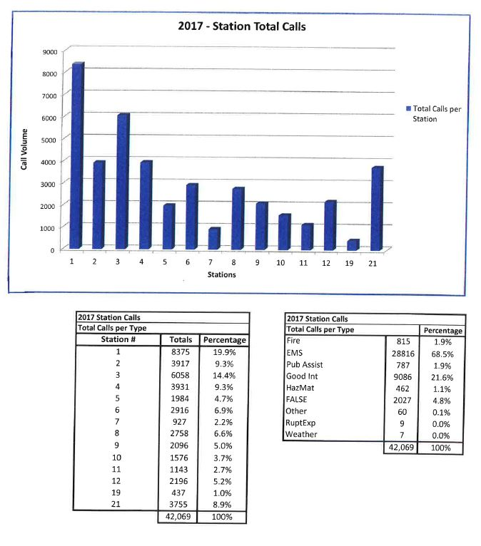
Follow-up from 2/21 Workshop
2017 Total Reno Fire Department Calls for Service: 42,069

Slide 29
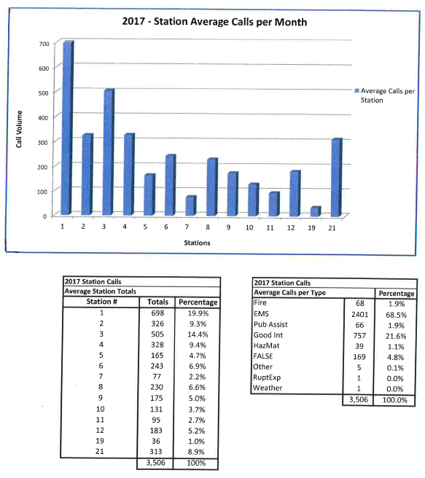
Follow-up from 2/21 Workshop
2017 Reno Fire Department Station Average Calls for Service per Month: 3,506

Slide 30
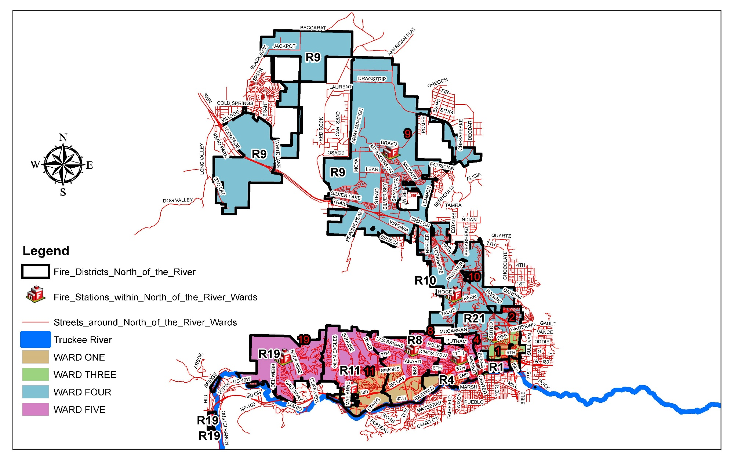
RFD Fire Districts – North
North Jurisdiction by WARD

Slide 31
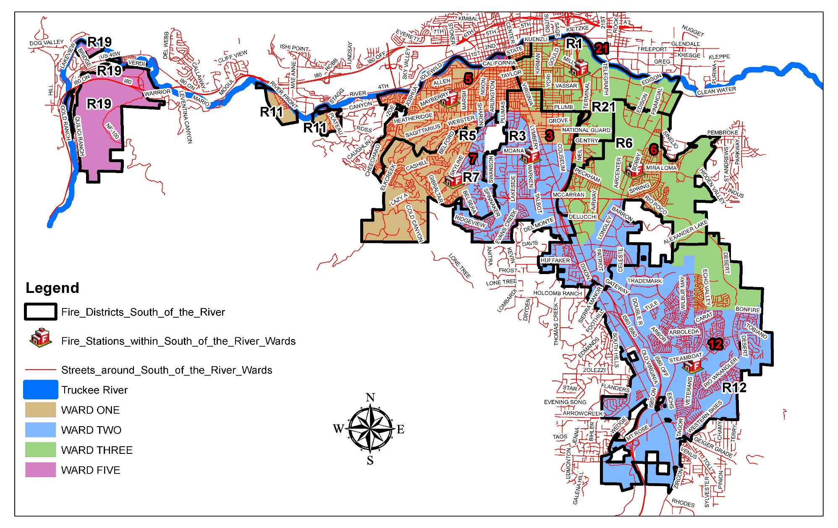
RFD Fire Districts – South
South Jurisdiction by WARD

Slide 32
FY 18/19
COUNCIL BUDGET
WORKSHOP
PUBLIC WORKS

Slide 33
Departmental Core Services
GENERAL FUND SERVICES
Facilities Maintenance
Downtown Maintenance
STREETS
SEWER
FLEET MANAGEMENT
Parking Meters
Capital Projects
Capital Projects
Street Sweeping
Snow & Ice Control
Sewer & Storm Drain Maintenance
Environmental Engineering
TMWRF & Stead Treatment Plants
Sewer Collection Systems
Environmental Control
Capital Projects
Pavement Maintenance
Paint and Sign
Right-of-Way Maintenance
Vehicle Acquisition
Vehicle Maintenance
TRAFFIC ENGINEERING
Transportation Planning
Traffic Signal Maintenance
Service Request Investigation & Response

Slide 34
Department Strategic Plan
  PRIMARY GOALS:
  Neighborhood Street Program and Sewer Replacement
  Readiness for Growth – Sewer Capacity
    Truckee Meadows & North Valleys
  Effluent Reuse Strategies
  Flood Resilience Projects
    Irrigation Ditches
    Truckee River
    North Valleys
  Small Cell Technology
  Vision Zero Traffic Safety
  Business Improvement District (BID)

Slide 35
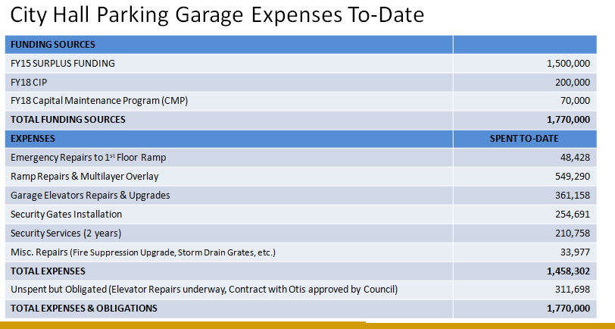
City Hall Parking Garage

Slide 36
FY 18/19
COUNCIL BUDGET WORKSHOP
CIVIL SERVICE COMMISSION

Slide 37
Departmental Core Services
The City of Reno Office of the Civil Service Commission (CSC) was mandated by the Nevada State Legislature in the Reno City Charter to be an autonomous body that oversees a merit system of competition.
The mission of the CSC is to provide an efficient workforce for the City of Reno.
The cornerstone of the City’s employment program is equity and fairness.
Employment with the City of Reno is accomplished through an individual’s demonstration of merit and fitness for the job in which an individual seeks to be employed.
The current CSC staff allocation of three (3) is responsible for recruiting, attracting, testing and presenting for selection the majority (approximately 93%) of the approximately 1200+ “regular” employees in the City’s total regular workforce

Slide 38
Departmental Core Services (CONT’D)
  Recruitment
  Outreach
  Job Posting
  Job Analysis
  Test Design and Administration
  Establish Eligibility Lists
    New hires
    Promotionals
  Administer the CSC Meetings

Slide 39
Department Strategic Plan
  PRIMARY GOALS:
  Innovate and update recruiting, outreach and testing and selection processes to:
    Benchmark and implement best practices towards that goal
    Reduce requisition to hire time
    Attract and maintain the best employees in a changing labor pool
    Provide more flexibility in hiring employees
    Present the best and most qualified candidates for departments to hire and promote
    Maintain fairness and equity in processes and procedures
    Collaborate with departments to review CSC rules to identify and streamline processes to be competitive in our labor force
    Provide outreach to the community about opportunities with the City
    Support the City’s Diversity Plan
  Present eligibility lists quarterly to fully staff Dispatcher positions by the end of the calendar year (this has not been done since the 1990’s)
  Provide education and training on CSC services, processes and procedures

Slide 40
FY 18/19
COUNCIL BUDGET
WORKSHOP
OFFICE OF COMMUNICATIONS AND COMMUNITY ENGAGEMENT(OCCE)

Slide 41
Departmental Core Services
  Support the City of Reno’s Vision, Mission and Strategic Priorities by:
    Informing and engaging citizens, employees, media, and Mayor/City Council
    Ensuring responsive communication
    Enhancing City services through community input
    Building trust through increased transparency

Slide 42

Departmental Core Services (CONT’D)
Community
Strategic
Communications
Digital
Engagement
Mayor
and
Council
Employees
Reno
Direct
Community
Engagement
Media

Slide 43
Department Strategic Plan
  Enhance and improve two-way communications with target audiences:
    Maintain and measure effectiveness of current communications tools
    Secure innovative, effective and cost-efficient communications tools to engage and inform target audiences with a focus on diversity and inclusion
    Enhance and improve media relations through the use of proactive outreach and messaging
    Develop programs that increase transparency, interest and participation in City of Reno activities
    Enhance and improve internal communications and build organizational pride among employees
    Develop media training opportunities Citywide

Slide 44
FY 18/19
COUNCIL BUDGET WORKSHOP
COMMUNITY DEVELOPMENT

Slide 45
Departmental Core Services
  Building and Safety Division:
  Responsible for plan review, permitting, and the enforcement of building codes and standards
  Strives to provide professional, efficient, and accurate services to developers, building professionals and citizens

Slide 46
Departmental Core Services (CONT’D)
  Business Licensing Division:
  Protect the public by assuring that businesses operate in a safe and appropriate manner
  Collect revenues for the general operation of the City

Slide 47
Departmental Core Services (CONT’D)
  Code Enforcement Division:
  Assure that citizens, businesses, and all others residing or operating in the City abide by the rules adopted by the City Council
  Frequently team with police, fire, Washoe County mental health, and other agencies on complex, multi-faceted issues

Slide 48
Departmental Core Services (CONT’D)
  Engineering Division:
  Reviews and inspects proposed building permits, maps, subdivisions, and other entitlements to ensure that they are designed and constructed to City standards
  Monitors the Engineer of Record and Materials Testing programs
  Inspection of all storm water pollution prevention plans associated with construction projects over an acre in size

Slide 49
Departmental Core Services (CONT’D)
  Housing & Neighborhood Development:
  Affordable housing, homelessness care and prevention, and enhancing accessibility
  Utilization of federal grant programs from the U.S. Department of Housing and Urban Development

Slide 50
Departmental Core Services (CONT’D)
  Planning Division:
  Engage citizens and other stakeholders in establishing a community vision through public workshops, neighborhood advisory boards, visioning exercises, and related activities
  Implement the community vision through the City of Reno Master Plan, zoning ordinance, and other regulations

Slide 51
Department Strategic Plan
  PRIMARY DEPARTMENT GOALS:
  Administration:
  Improve customer service
  Improve planning and engineering application review times
  Continue the Drop In with CD, Community Development Conversations, and Department newsletter programs

Slide 52
Department Strategic Plan (CONT’D)
  Building:
Regional adoption and implementation of the 2018 International Codes, ensuring consistency across northern Nevada jurisdictions
Development of an Interlocal Agreement with Washoe County District Health for 10-day plan review of Reno building permits that are properly submitted
Increase by 10% the number of contractors and builders with ACA accounts for online scheduling, and cross-training employees in division on permit intake

Slide 53
Department Strategic plan (CONT’D)
  Building (cont’d):
Develop fully integrated, customer-initiated online permit application prior to the Building and Safety Division occupying the 6th floor late March 2018
Complete development and begin mandatory electronic submittal of all commercial plans
Year over year changes (2017 to 2018 Estimate) Building permits: 9,000 to 10,500 (16.7% Increase) Inspections: 52,000 to 61,000 (17.3% Increase)

Slide 54
Department Strategic plan (CONT’D)
Business License:
Refine the license renewal and amendment process in the new Accela Civic platform to improve efficiencies for staff and customers
Integration of the Secretary of State Business Licensing platform SilverFlume with the new Accela Civic platform to streamline the licensing process
Continue public outreach to educate customers on how to migrate and utilize the regional online licensing and permits portal, ONENV.US, to conduct business online

Slide 55
Department Strategic Plan (CONT’D)
Code Enforcement
Implement new motel inspection program with minimum standards for single room occupancies
Re-establish public education program to prevent code violations, include attending Neighborhood Advisory Board meetings on a regular basis
92% of cases are responses to complaints/8% of cases are proactive
Average annual cases per officer have increased from 552 to 813 since 2012 (47% increase)

Slide 56
Department Strategic Plan (CONT’D)
Engineering:
More efficient review of proposed subdivisions and more thorough inspections of infrastructure
Implement and provide ongoing support to quality assurance and SWPPP programs
Improve engineering application review times

Slide 57
Department Strategic Plan (CONT’D)
Housing and Neighborhood Development:
Maintain high standards for regulatory and program requirements
Continue to develop and maintain good relations with major funders

Slide 58
Department Strategic Plan (CONT’D)
Housing and Neighborhood Development (cont’d):
Maintain a balance between effectiveness and compliance in the programs managed as rules and regulations are being revised
Develop and implement an extremely low income affordable housing project with wrap around services.

Slide 59
Department Strategic Plan (CONT’D)
Planning:
Support historic preservation, new development, and an enhanced focus on community outreach
Process a comprehensive revision of RMC Title 18, Annexation and Land Development
Improve planning application review times

Slide 60
FY 18/19
COUNCIL BUDGET
WORKSHOP
DEPARTMENT OF INFORMATION TECHNOLOGY

Slide 61
Departmental Core Services
  Centralized IT Services
    Email, Desktop Support, Phones, City Issued Device Management, Etc.
  IT Project Management & Enterprise IT Services
    Application Discovery -> Acquisition -> Implementation -> Maintenance -> Review
  Network Infrastructure Management
    Routers, switches, firewalls, Internet/Intranet, Security
  Server/Data Infrastructure Management
    Scalable, cost-efficient and improved system utilization

Slide 62
Departmental Core Services (CONT’D)
  Departmental + IT Partnerships
    Police – BWC, Field Reports, Mobile Tools, Security Cameras
    Fire – Data quality and Field Reporting
    Dispatch – Computer Aided Dispatch
    Finance – Financial and Budgeting System
    HR – Onboarding, Building Access System Badges, Payroll
    City Clerk – Records retention and Public Requests
    CD – Robust mobile tools, Building permits, GIS
    PW – Parking Ticketing App, SCADA, Mobile Devices for field personnel, Building Maintenance System, Asset Management
    CMO - Big Data Aggregation, Policy Driven Dashboards and Open Data Portals, Security System
    Regional Partnerships – Smart City Initiatives, Interfaces to transfer data between agencies, Public Safety Systems/Applications

Slide 63
Department Strategic Plan
  PRIMARY GOALS OF SERVICES:
    IT Availability
    IT Invisibility
    IT Responsibility
    IT Efficiency
  PRIMARY GOALS OF INFRASTRUCTURE:
    Robust infrastructure of networks and servers
    Continuity of Services
    Cybersecurity
    Capacity Growth

Slide 64
FY 18/19
COUNCIL BUDGET
WORKSHOP
FINANCE DEPARTMENT

Slide 65
Departmental Core Services
  Accounting
  Operational accounting and financial services
    Compliance with GASB, policies & procedures, etc.
    Management of debt portfolio
    All accounting-related activities
  Budgeting
  Oversight and management of budget for all funds and accounts
  Provide budget, fiscal and general issue analysis
  Financial Planning
  Overall financial reporting and financial updates
  Manage investment portfolio
  Organizational Support
  Procurement
  City mail
  Sewer Billing
  Maintenance of an effective and efficient sewer billing process

Slide 66
Department Strategic Plan
  PRIMARY GOALS:
    Research potential restructuring of the Redevelopment Agency Bonds
    Monitor all debt service
      Initiate restructuring when economically feasible, including preparation of annual debt management report and updated policy.
    Monitor economic conditions with constant review of revenues and expenditures
      Review and update Budget Guiding Principles
    Continue enhanced collection efforts in all areas
      Sewer billing, parking tickets, code enforcement, etc.

Slide 67
FY 18/19
COUNCIL BUDGET WORKSHOP
HUMAN RESOURCES

Slide 68
Departmental Core Services
  Recruitment & Development Program
  Employee Services Program
  Employee & Labor Relations Program
  Compliance Program

Slide 69
Department Strategic Plan
  FUTURE GOALS:
    Build a robust and meaningful Learning & Development Program for the City of Reno
    Analyze, identify, and maximize efficiencies in all HR program areas
    Assist in facilitation of organizational culture change through inter-departmental collaboration
    Improve information resources for employees regarding health and benefits programs

Slide 70
FY 18/19
COUNCIL BUDGET WORKSHOP
MUNICIPAL COURT

Slide 71
Departmental Core Services
Reno Municipal Court (RMC) is a busy 4 judge limited jurisdiction court, supported by 46 highly-skilled professionals, processing almost 20,000 cases each year and maintaining several unique specialty court programs.
The Court is an adult court of record, established by Chapter 5 of the Nevada Revised Statutes and adopted by the City of Reno Municipal Charter.
RMC’s core services are to impartially adjudicate misdemeanor crimes and code violations, provide supervised rehabilitation services to those needing treatment, operate in a cost-effective manner, provide safe and equal access to justice to all court users, maintain the integrity and independence of the judiciary, and preserve the confidence and respect of those coming before the Bench.

Slide 72
Department Strategic Plan
  PRIMARY GOAL 1: MAINTAIN A MODEL COURT ENVIRONMENT
  Continue to provide quality customer service both at the courthouse and online
    Developed a new check-in and payment process that opens 8 windows during peak times
  Continue to make operational changes, such as introducing new technology, without impacting the court’s calendar, performance or budget
    Text notification of upcoming hearing and payment due dates
  Continue to strengthen community relationships by working closely with city management, holding kids court, adopting a local school, making presentations at high schools and participating in special events
    Participated in the State of the City – Department Showcase

Slide 73
Department Strategic Plan (CONT’D)
PRIMARY GOAL 2: EXPAND THE USE OF TECHNOLOGY
  Continue to audit all active cases and workflows to ensure efficiencies and compliance to state and federal laws as well as Supreme Court mandates
    RMC was the first court in the State to have it’s case management system certified by the Nevada Supreme Court
  Continue to advance the Electronic Case File project
    Research and implement new electronic features, such as digital signatures and file stamps
  Continue to upgrade the Court’s recently redesign website
      Easy to navigate to primary areas of interest, such as online payments
      and select your own traffic arraignment date
  Fully utilize the Court’s recently installed digital signage
      Helps to direct foot traffic and provides real-time information

Slide 74
Department Strategic Plan (CONT’D)
PRIMARY GOAL 3: GROW SPECIALTY COURT PROGRAMS
  Effectively utilize a limited budget to serve the growing population of specialty court participants
    6 programs, 261 participants, 82 graduates last year
  Continue to identify new strategies to support specialty court participants
    Assist with housing placement, job training, and life-skills workshops
    Mobile breathalyzers
  RMC is one of only a few courts throughout the nation selected to receive federal training in veteran’s treatment strategies
      RMC is planning to pilot a Veteran’s Court in the fall of this year
  Continued to support Project Homeless Connect
      Court is conducted offsite, usually at the homeless shelter or Reno Event Center

Slide 75

FY 18/19
COUNCIL BUDGET
WORKSHOP
PARKS, RECREATION & COMMUNITY SERVICES

Slide 76
Departmental Core Services
    Parks Maintenance
    87 Parks (54 restrooms; 78 playground structures; 264 acres turf)
    1,900 acres of open space (16 miles of maintained trails)
    Urban Forestry
    1,444 trees pruned (72% of target)
    Ratio of trees planted vs. removed = 1 : 1.2
    Recreation Centers
    6 Recreation Centers/Historical Buildings, 19 Park Shelters (16 park locations)
    nearly 27,000 visits
    over 1,400 facility use rental permits
    Aquatics
    2 indoor pools, 2 outdoor pools
    1,619 swim lesson participants (2 pools closed for repairs)
    1,913 water fitness participants
    40,283 lap swim/open swim participants
    Youth Recreation Programs
    Sierra Kids Before & After-School Program
      53,726 registrations
    Summer and School Break Camps
      7,629 registrations
Notes:
6 Recreation Centers/Historical Buildings:
EMNECC
NRRC
Plumas Gym
McKinley Arts & Culture Center
California Building
Southside School
1,215 Memberships/Passes
24,400 Point of Sale/Drop Ins
Facility Rental Contracts (total number of contracts does not equal multiple rentals by same user)
255 Park Shelter Rentals ($33k revenue)
564 EMNECC ($34k)
172 NRRC ($16k)
66 Plumas Gym ($9k)
189 McKinley Arts & Culture Center ($26k, doesn’t include monthly rent payments from tenants which is addt’l $43k)
162 California Building ($27k)
7 Southside School ($550k, doesn’t include monthly rent payments from tenants which is addt’l $35k)
1,251 Water Fit Class Passes
662 Water Fit Drop In
27,710 Lap/Open Drop In
14,573 Lap/Open Passes

Slide 77
Departmental Core Services (CONT’D)
    Senior Recreation Programs
Senior games, trips, dinner and shows, brunch and movies etc..
  Activity Participants 6,381
  Facility Drop In Use 47,833
  Facility Memberships 636
    Therapeutic Recreation Programs
9 Adaptive programs, including 4 Veterans programs
Inclusion services in Youth programs serving children with special needs
    Adult Athletics Programs
5 ballfields, 2 gymnasiums | softball, kickball, basketball & volleyball leagues
nearly 6,000 participants and 30 tournaments
Grants/Volunteers/Scholarships
Department raised over $1.1 million dollars through grant funding in 2017
Department Volunteer Hours - 5,181 hours ($122,064 value)
Provided 478 scholarships to youth and senior participants ($338,855 value)
Notes:
Adaptive Programs (Project HERO, Military to the Mountains, Military Sports Camp, Fit but not Forgotten, Wheelchair Basketball, Wheelchair Rugby, Adaptive Rental Program, Adaptive Dance Series, Adaptive Cycling Series)
Softball teams (296 teams in 2 season x 12 people per team average = 3,552 people)
Kickball teams (33 teams x 12 people per team average = 396 people)
# of field rentals 30 for tournaments and single day rentals
Basketball (76 teams x 7 players per team average = 532 people)
Volleyball teams (187 teams in 4 seasons x 8 person per team average = 1,496 people)

Slide 78
Department Strategic Plan
PRIMARY GOALS:
Succession Planning
Improve Park Maintenance
Growth Demands vs. Park Maintenance Ability
  Somersett West Park
  Mayor’s/McAlinden Park Master Plan/Development
  Downtown Dog Park
  Cyan Park
  Sierra Vista Park
  Moana Springs Pool
*Combined total of 296.5 additional acres

Slide 79
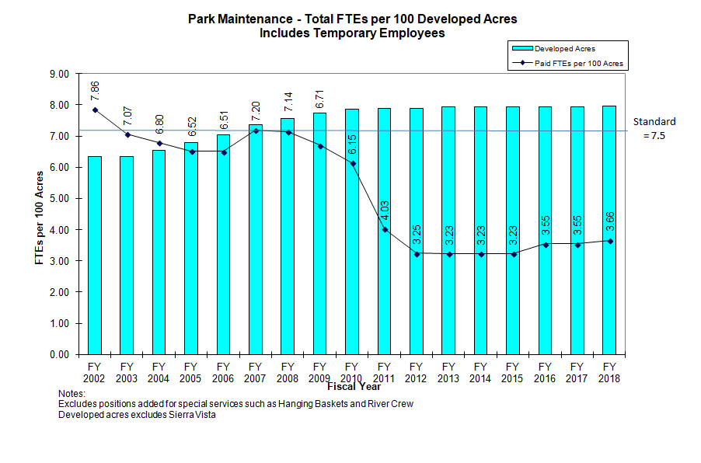
Department Strategic Plan (CONT’D)
Notes:
Add info on 4 PCR requested additional positions to notes for this slide.

Slide 80
FY 18/19
COUNCIL BUDGET
WORKSHOP
CITY CLERK

Slide 81
Departmental Core Services
COUNCIL SUPPORT
  Maintain official record, journal, laws, minutes and proceedings all of Council Meeting
  Boards and Commissions
CENTRAL CASHIERING
  All payments
  Parking Permit Program Administration
RECORDS MANAGEMENT
  Public Records
  Document and retention management

Slide 82
Department Strategic Plan
  PRIMARY GOALS:
  Electronic Records
  Federal, State, and Local law adherence
  Customer Service
  DMV Holds
  Continued Efficiencies

Slide 83
FY 18/19
COUNCIL BUDGET
WORKSHOP
CITY MANAGER

Slide 84
DEPARTMENTAL CORE SERVICES
Departmental Core Services
Administration
  Senior Management & Administration
  Citywide Strategic Planning Efforts
  Coordination & Support
Intergovernmental Relations
  Lobbying
  Regional Coordination
  Federal Legislative Program
  Special Projects

Slide 85
DEPARTMENTAL CORE SERVICES
Departmental Core Services (CONT’D)
Office of Arts, Culture & Special Events
  Public Art
    Public Art Program
    Arts and Culture Commission
Office of Arts, Culture & Special Events
  Special Events
    Permitting & Coordination
    Special Events Sponsorship Program
    Reno City Council Special Events Subcommittee
    Grant and Sponsorship
    Programs

Slide 86
DEPARTMENTAL CORE SERVICES
Departmental Core Services (CONT’D)
Office of Economic Development
  Business Development
  Redevelopment
  Downtown Revitalization
Sustainability
  ReLeaf & ReEnergize Programs
  Strategic Sustainability & Climate Action Plan
  Collaboration & Engagement

Slide 87
DEPARTMENT STRATEGIC PLAN
Department Strategic Plan
  PRIMARY GOALS:
    Update, improve, and train employees on City policies and procedures.
    Further strategic planning throughout organization.
    Improve performance management and data-driven decision making.
    Support process improvement, streamlining efforts, innovation, and best practices.
    Continue focus on developing a positive and professional organizational culture.

Slide 88
DEPARTMENT STRATEGIC PLAN
Department Strategic Plan (CONT’D)
  PRIMARY GOALS:
    Develop Federal and State legislative platforms.
    Maintain our role as a leader in arts, culture, and special events.
    Ensure success of Downtown Management Organization and Business Improvement District.
    Work with regional and community partners to expand programs that reduce climate pollution.

Slide 89
FY 18/19
COUNCIL BUDGET
WORKSHOP
CITY ATTORNEY’S OFFICE

Slide 90
Departmental Core Services
The City Attorney’s Office (“CAO”) provides a full range of legal services to the City of Reno, including legal advice and counsel, civil litigation, criminal prosecution and risk management. The CAO consists of three divisions:
  Civil Division - Provides readily accessible, cost effective, high quality legal advice and counsel to City Council and staff.
  Criminal Division - Achieves justice through effective prosecution of misdemeanor offenses.
  Risk Division - Minimizes losses and costs related to property and liability claims through proactive and effective risk management.
  As part of each division’s mission, the CAO emphasizes staff development, training, education and the practice of preventative law.

Slide 91
Departmental Strategic Plan
Civil Division
  Reno Municipal Code Update
    General procedures
    Appeals
    Adult business regulations
    Sign code
    Affordable housing
  Litigation
    Employment and Labor
    Civil rights
    North Valley Flooding
    Adult business regulations
    Sign code
    Solid waste litigation
Criminal Division
  Aggressive prosecution of driving while under the influence (DUI) cases.
  Aggressive prosecution of domestic violence cases.
  Aggressive prosecution graffiti and nuisance cases.
  Specialty courts
Risk Division
  Minimizes losses and costs related to property and liability claims

Slide 92
Council Budget Priorities

Slide 93
Council Budget Priorities
Discussion regarding Council’s budget priorities for FY 2018-19
Next Steps
  March 26 – Receive State Pro Forma projections
  March 28 – Update Council on FY18 Budget
  April 15 – Tentative City Budget due to State
  April 17-26 – Council Budget Briefings
  1st and 2nd weeks May – Council Budget Workshops (including public engagement)
  May 16 – Public Hearing & Budget Adoption
  June 1 – Budget due to State

Slide 94
Questions?

