Slide 1
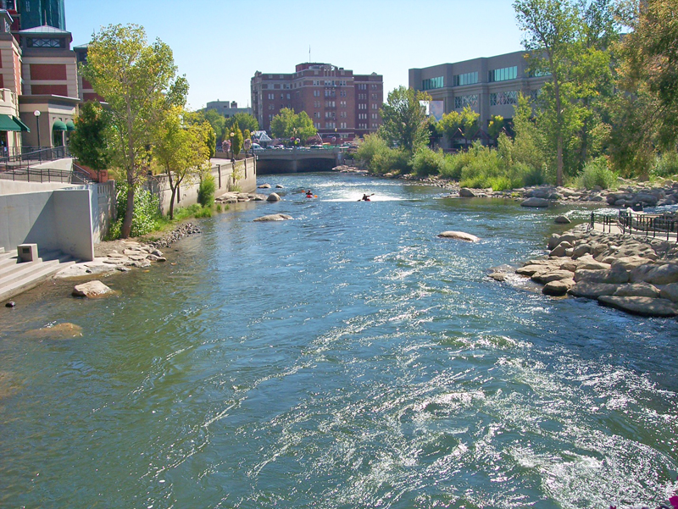
City of Reno Council Workshop
Finance
February 21, 2018

Slide 2
February 21, 2018 Agenda:
Fiscal Overview
Balanced Budget Strategies
Program Change Requests
Capital Improvement Plan (CIP)
Debt Overview

Slide 3
Fiscal Overview

Slide 4
General Fund Balance History

Slide 5
General Fund Budget W/O 1-Time

Slide 6
General Fund Adopted Budget-Expenditures

Slide 7
FY 17/18

Slide 8
FY 17/18 General Fund Summary

Slide 9
General Fund 17/18
Initial Budget Balancing
Notes:
Salary savings=vacancy factor

Slide 10
General Fund 17/18
Re-Estimated Budget Potential Balancing
Notes:
Fund balance available if fund balance at 8.3% $2,378,917
Sale of Land available $1,885,633
If fund deficit and CIP total left $3,187,128
Services and Supplies are estimated at 20% of prior year savings
Note Only: Additional Fund balance available if fund balance at 7.5% $1,367,458

Slide 11
FY 18/19

Slide 12
FY 18/19 General Fund Revenues
Notes:
Without fund balance, property tax and Ctax are 57% of the revenues

Slide 13
FY 18/19 General Fund Expenditures by Category
Notes:
Requested budget more than available revenues so total does not match to revenue chart

Slide 14
FY 18/19 General Fund Expenditures
Other-reduced by Freight House, BID, non-city programs arts & culture, baseball, transfers out, debt service, capital, pay go

Slide 15
FY 18/19 General Fund Summary

Slide 16
FY18/19 Non-Discretionary PCR’s

Slide 17
General Fund 18/19
Potential Budget Balancing Ideas
Notes:
Salary Savings=vacancy factor
Use $3,187,128 of excess fund balance-after use fund balance at 8.3%
Departmental Reductions may require reductions in force.

Slide 18
Balanced Budget Strategies

Slide 19
History of Budget Balancing
Historically Reno has balanced the General Fund Budget by:
  Use of Beginning Fund Balance in excess of 7%.
  Funding Reduced for Risk (when reserves in Risk more than required.)
  Kept funding flat for Workers Comp (Prohibits City from reducing Heart-Lung Liability.)
  Kept Funding flat for Motor Vehicle Rental.
  Build in anticipated salary savings
  Build in anticipated current year services and supplies savings
  Reduced Contingency - $1.1m reduction
  Other 1-time funds –property sales; CIP savings; medical premium holidays.
Notes:
Reduction in Fleed does not allow Fleet to purchase more than $2m-$3m in replacements year to year, useful life of vehicles continue to be increased and repair costs increase

Slide 20
Budget Reduction Strategies
Departmental Budget Reduction Strategies
  Across the board % reduction
  Department reductions factoring in % of the Total Budget.
  Reducing Non-Core services.
  Reduction in Force

Slide 21
Strategies for Use of 1-time Resources
Fiscal Year end savings
  Increase Fund Balance/OPEB Funding/Workers Comp Funding
  One time capital projects
  One time department requested increases
1-time revenues-property sales
  One time capital projects

Slide 22
FY 18/19
Program Change Requests

Slide 23
PCR’s Totals by Department/Fund

Slide 24
PCR FTE’s by Department/Fund

Slide 25
FY 18/19
Capital Improvement Plan (CIP)

Slide 26
FY 18/19 Capital Improvement Plan (CIP)
The Capital Improvement Plan guides the construction and major maintenance of City facilities and infrastructure.
Constitutes a critical component in the City’s system of planning, monitoring, and managing municipal activities.
Links together in a single process the annual cycle of planning, budgeting, implementation, and quality assessment activities.
CIP Committee met in February to review FY 18/19 projects and provide recommendations for projects to be funded.

Slide 27
Capital Improvement Plan by Fund

Slide 28
FY 18/19 Capital Improvement Plan (CIP)
Funding Source: City Capital Projects Fund (Fund 30000) is funded via a General Fund Transfer. Of all the CIP funds, this is the least restrictive, and thus gets the most competition for projects.

Slide 29
FY 18/19 Capital Improvement Plan (CIP)
Funding Source: CDBG Entitlement Grant for the Department of Housing and Urban Development (HUD)

Slide 30
Historic General Fund CIP Request

Slide 31
Debt Overview

Slide 32
Debt By Use – As of June 30, 2017
ReTrac | $ 190,693,227
Event Center/NBS/Ballroom | 114,352,556
Sewer | 59,056,018
Redevelopment Agency | 22,410,000
Special Assessment District | 19,992,120
Streets | 12,655,000
Other | 48,768,574
Total | $ 467,927,495

Slide 33
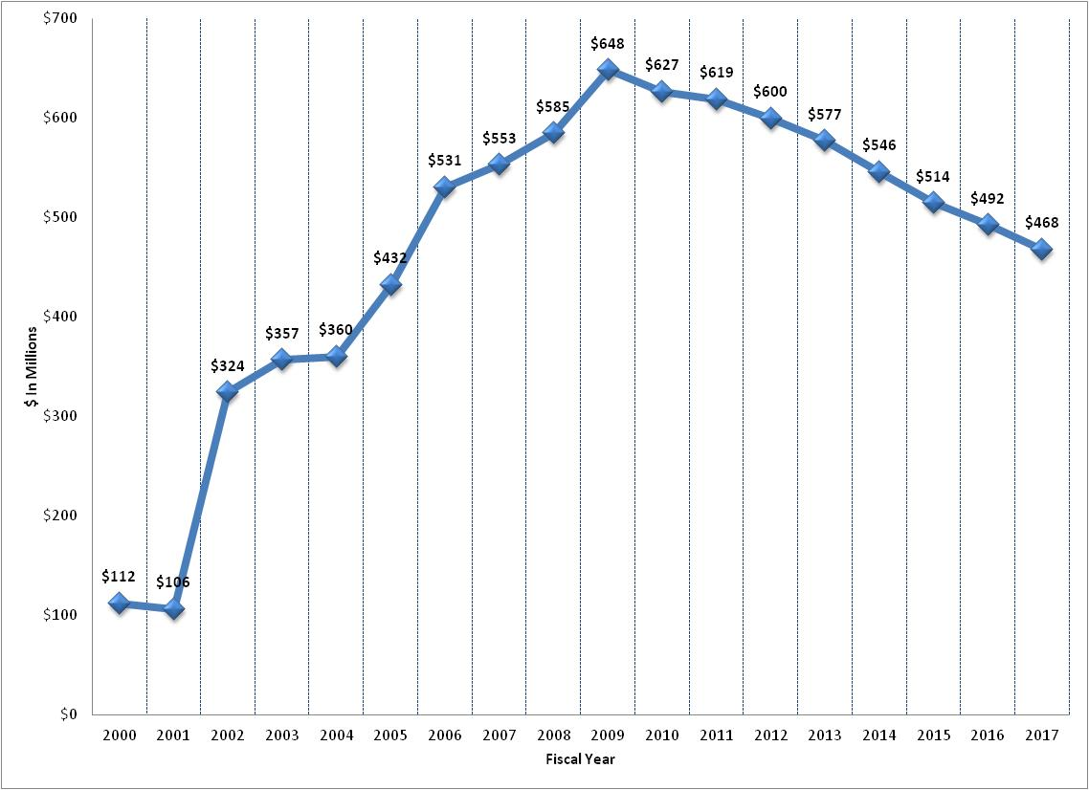
Bond Debt: 2000 – 2017

Slide 34
Questions?

Slide 35
Supplemental Information

Slide 36
FY18/19 General Fund

Slide 37
FY18/19 Room Tax Fund Council
 | Notes | FY17/18 Estimated | FY 18/19 Requested
Room Taxes |  | $1,200,000 | $1,200,000
Miscellaneous |  | $11,500 | $5,000
Beginning Fund Balance |  | $1,002,991 | $393,695
Total Resources |  | $2,214,491 | $1,598,695
Pioneer Center |  | $50,960 | $50,960
KTMB |  | $15,000 | $15,000
Arts Commission | Includes prior year carry forward | $284,271 | $205,406
Administrative Costs |  | $13,770 | $19,244
Special Events Support |  | $530,736 | $545,212
Artown Support | Includes prior year carry forward | $135,000 | $125,000
Art in Public Places | Includes prior year carry forward | $299,178 | $50,000
Sternberg Poles |  | $100,000 | $100,000
Jack Tighe Parking Lot |  | $200,000 | $0
Downtown Lamp Replace | Includes prior year carry forward | $4,381 | $0
DMO |  | $187,500 | $0
Amtrak ADA Restroom |  |  | $120,000
Recommended Reserve |  |  | $307,705
Remaining Fund Balance |  | $393,695 | $60,168
Total Expenditures |  | $2,214,491 | $1,598,695
Notes:
Admin cost are for risk and indirect costs
Special Events support includes 1 position at $157,915

Slide 38
FY18/19 Room Tax Fund PRCS
 | FY17/18 Estimated | FY 18/19 Requested
Room Taxes | $1,200,000 | $1,200,000
Miscellaneous | $0 | $0
Beginning Fund Balance | $491,288 | $336,177
Total Resources | $1,691,288 | $1,536,177
Irrigation System Technician | $96,652 | $84,876
Additional Mowing | $30,000 | $30,000
Park Camera’s | $92,820 | $0
Parks Support | $935,639 | $973,348
Idlewild Pool | $200,000 | $0
Recommended Reserve |  | $272,056
Remaining Fund Balance | $336,177 | $175,897
Total Expenditures | $1,691,288 | $1,536,177

Slide 39
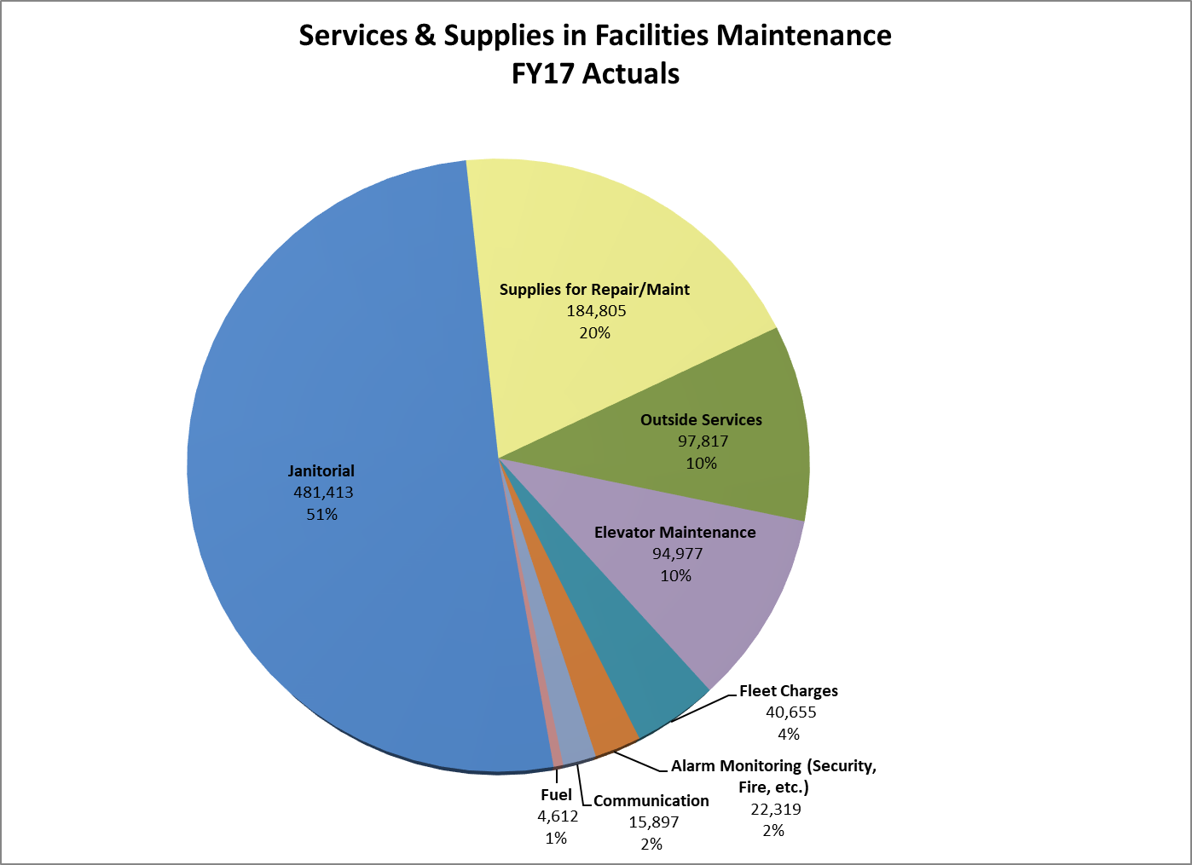
FY 16/17 Actual Facilities Maint Services & Supplies

Slide 40
Facility Maint Required Maint Hours by Building

